Slide 1
Ripasso - Phonics Unità 1
Spell the following words: (Ext. What do they mean in English?)
centro
voce
città
amici
veloce
cibo
calcio
Notes:
Teacher says the word students write it down (on mini whiteboards?) check after each word and correct misspellings
centro
voce
città
amici
veloce
cibo
calcio

Slide 2
ch
ch
chiave

Slide 3
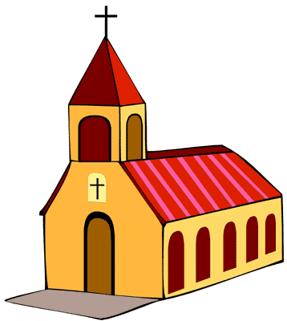
[to call]
ch
chiamare
chiesa
chiave
[clear, light]
chiaro
[why, because]
che?
perché

Slide 4
chiamare
chiesa
chiave
chiaro
che?
perché

Slide 5
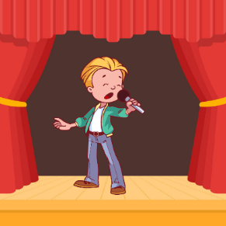
CH, CA o CO?
ascoltare/scrivere
1
3
___sta
co
__ntare
ca
5
pic___lo
co
2
4
[why, because]
ch
ch
per___é
__iave
Notes:
Phonics practice activity [1/2]
Timing: 5 minutes
Aim: to practice mapping the sound of [ca], [co] and [ch] to their spellings
Procedure:
1. Students write 1-5.
2. Students listen and write the missing letters.
3. Teacher checks answers
Note: a variation of this activity is on slides 11-12 (students write the full word)

Slide 6
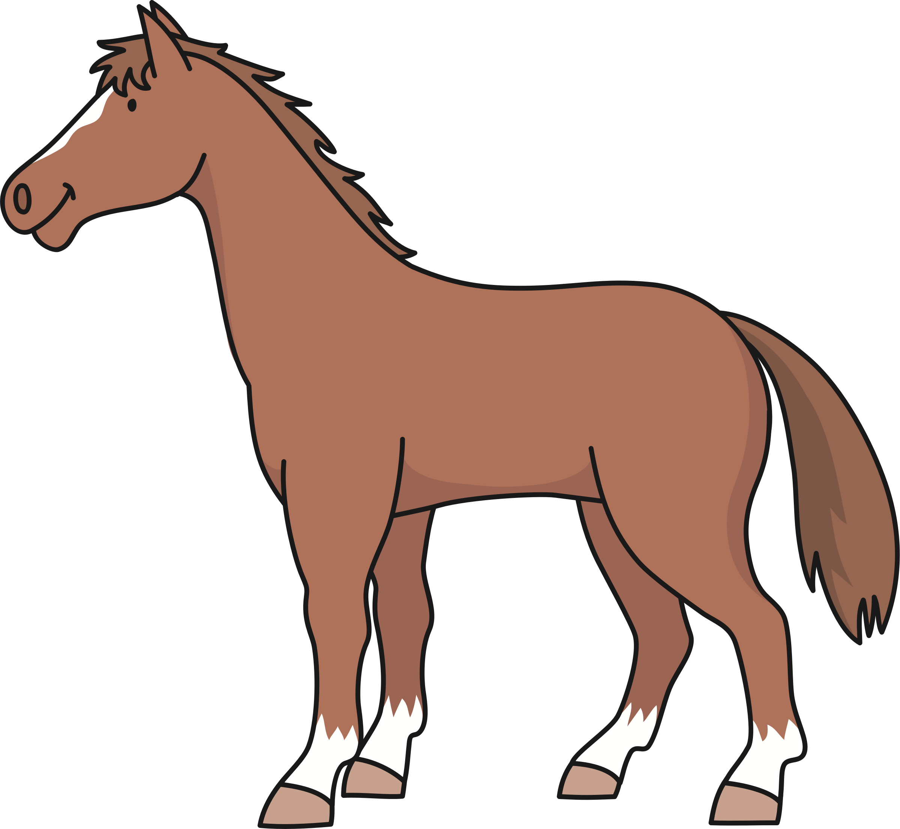
CH, CA o CO?
ascoltare/scrivere
Con ketchup
6
8
__e?
co
ch
__n
10
ca
__vallo
7
9
ca
__sa
___iesa
ch
Notes:
Phonics practice activity [2/2]

Slide 7
CH, CA o CO?
ascoltare/scrivere
1
3
costa
cantare
5
piccolo
2
4
[why, because]
chiave
perché
Notes:
Phonics practice activity [1/2]
Timing: 5 minutes
Aim: to practice mapping the sound of [ca], [co] and [ch] to their spellings
Procedure:
1. Students write 1-5.
2. Students listen and write the missing letters.
3. Teacher checks answers
Note: a variation of this activity is on slides 11-12 (students write the full word)

Slide 8
CH, CA o CO?
ascoltare/scrivere
Con ketchup
6
8
che?
con
10
cavallo
7
9
casa
chiesa
Notes:
Phonics practice activity [2/2]

