Slide 1
Ripasso - Unità 5 - Phonics
Spell the following words: (Ext. What do they mean in English?)
dodici
molto
solo
mondo
orso
con
Notes:
Teacher says the word students write it down (on mini whiteboards?) check after each word and correct misspellings

Slide 2
ca

Slide 3
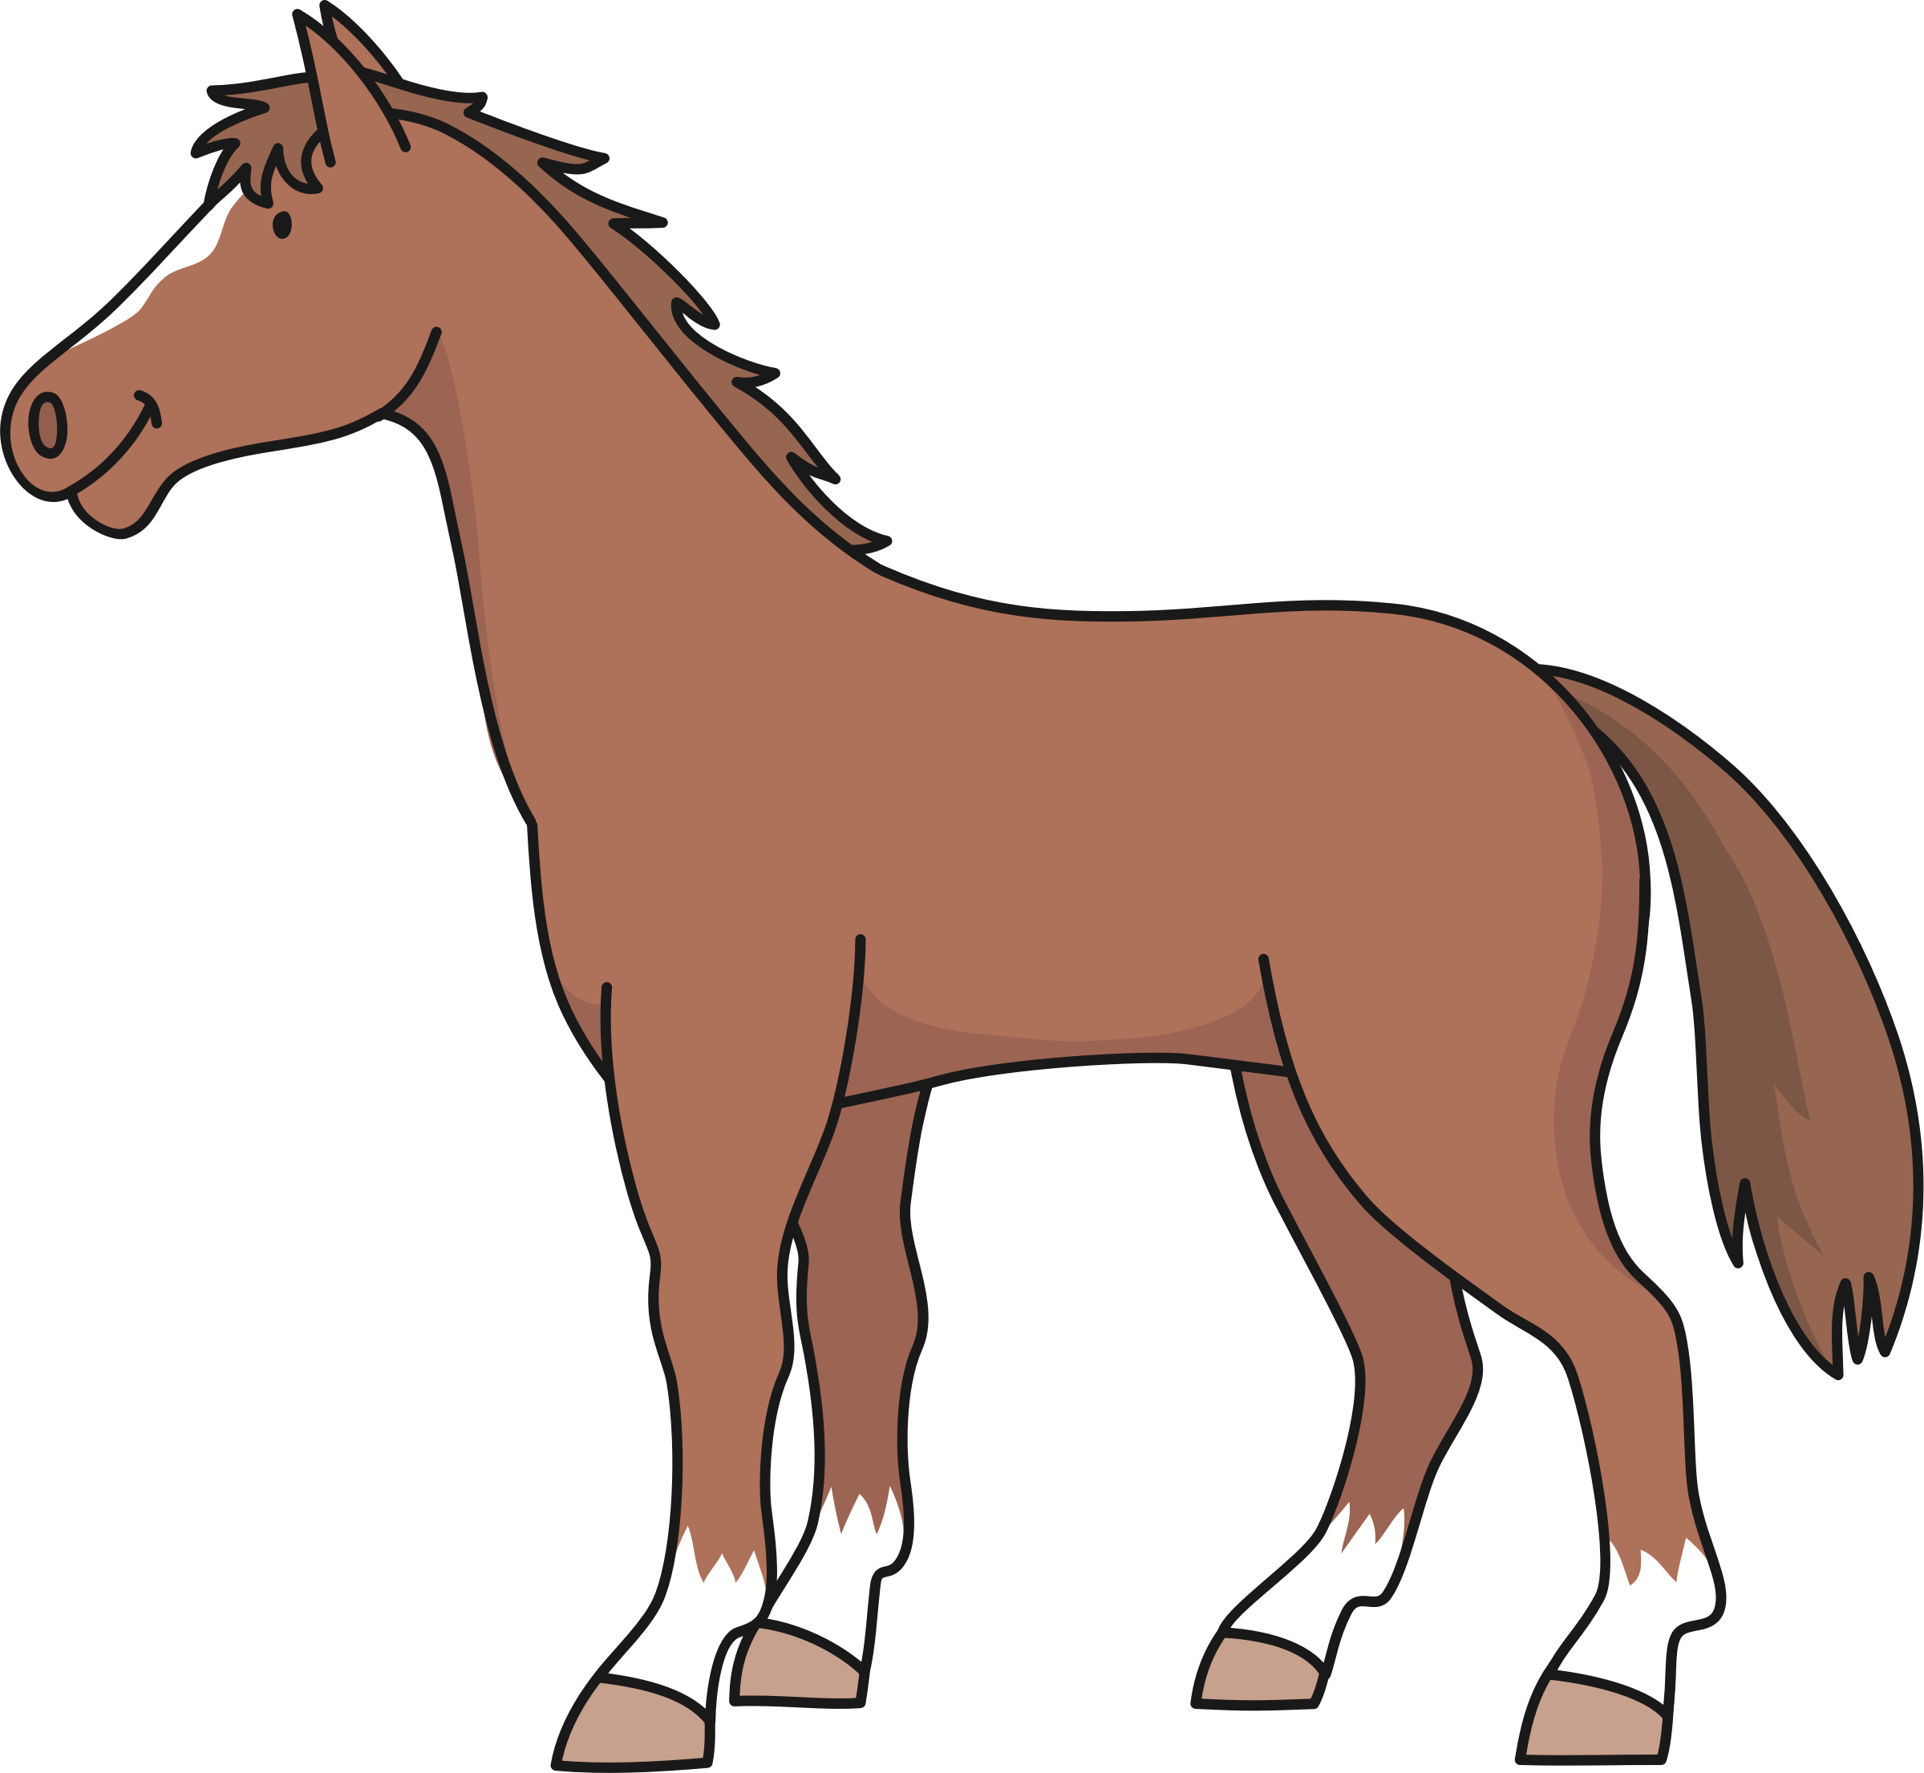
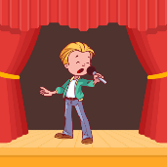
cavallo
campo
£
$
calcio
cantare
cambiare
Notes:
Introduce and elicit the pronunciation of the individual SSC ‘ca’’ and then the source word again Then present and elicit the pronunciation of the three cluster words.

Slide 4
cavallo
campo
£
$
calcio
cantare
cambiare
Notes:
Introduce and elicit the pronunciation of the individual SSC ‘ci’ and then the source word again (with gesture, if using). Then present and elicit the pronunciation of the three cluster words.
The cluster words have been chosen for their high-frequency, from a range of word classes, with the SSC (where possible) positioned within a variety of syllables within the words (e.g. initial, 2nd, final etc..) and additionally, we have tried to use words that build cumulatively on previously taught SSCs (see the Phonics Teaching Sequence document) and do not include new SSCs. Where new SSCs are used, they are often consonants which have a similar symbol-sound correspondence in English.

Slide 5
co
corpo
Notes:
Without the images, students focus this time again closely on the SSC and the cluster words.

Slide 6
con ketchup
costa
con
corpo
bianco
piccolo
come?

Slide 7
con ketchup
costa
con
corpo
bianco
piccolo
come?
Notes:
Without the images, students focus this time again closely on the SSC and the cluster words.

Slide 8
cu
cultura
Notes:
Introduce and elicit the pronunciation of the individual SSC ‘ce’ and then the source word again (with gesture, if using). Then present and elicit the pronunciation of the three cluster words.
The cluster words have been chosen for their high-frequency, from a range of word classes, with the SSC (where possible) positioned within a variety of syllables within the words (e.g. initial, 2nd, final etc..) and additionally, we have tried to use words that build cumulatively on previously taught SSCs (see the Phonics Teaching Sequence document) and do not include new SSCs. Where new SSCs are used, they are often consonants which have a similar symbol-sound correspondence in English.

Slide 9
cu
cultura
Notes:
Introduce and elicit the pronunciation of the individual SSC ‘ce’ and then the source word again (with gesture, if using). Then present and elicit the pronunciation of the three cluster words.
The cluster words have been chosen for their high-frequency, from a range of word classes, with the SSC (where possible) positioned within a variety of syllables within the words (e.g. initial, 2nd, final etc..) and additionally, we have tried to use words that build cumulatively on previously taught SSCs (see the Phonics Teaching Sequence document) and do not include new SSCs. Where new SSCs are used, they are often consonants which have a similar symbol-sound correspondence in English.

Slide 10
cuore
scuro
cultura
scuola
cucina
cuoco
Notes:
Introduce and elicit the pronunciation of the individual SSC ‘ce’ and then the source word again (with gesture, if using). Then present and elicit the pronunciation of the three cluster words.
The cluster words have been chosen for their high-frequency, from a range of word classes, with the SSC (where possible) positioned within a variety of syllables within the words (e.g. initial, 2nd, final etc..) and additionally, we have tried to use words that build cumulatively on previously taught SSCs (see the Phonics Teaching Sequence document) and do not include new SSCs. Where new SSCs are used, they are often consonants which have a similar symbol-sound correspondence in English.

Slide 11
cuore
scuro
cultura
scuola
cucina
cuoco
Notes:
Introduce and elicit the pronunciation of the individual SSC ‘ce’ and then the source word again (with gesture, if using). Then present and elicit the pronunciation of the three cluster words.
The cluster words have been chosen for their high-frequency, from a range of word classes, with the SSC (where possible) positioned within a variety of syllables within the words (e.g. initial, 2nd, final etc..) and additionally, we have tried to use words that build cumulatively on previously taught SSCs (see the Phonics Teaching Sequence document) and do not include new SSCs. Where new SSCs are used, they are often consonants which have a similar symbol-sound correspondence in English.

Slide 12
corpo
cultura

Slide 13
ca / co / cu?
co
_ _sta
cu
_ _oco
ca
_ _vallo

