Slide 1
Ripasso - Unità 3 - Phonics
Spell the following words: (Ext. What do they mean in English?)
idea
interessante
libro
primo
lista
bicicletta
isola
Notes:
Teacher says the word students write it down (on mini whiteboards?) check after each word and correct misspellings
idea
interessante
libro
primo
lista
bicicletta
isola

Slide 2
u

Slide 3
u

Slide 4
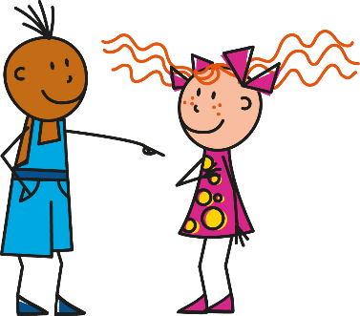
uno
[a; an]
tu
su
usare
[on]
musica
[to use]
‹#›

Slide 5
u
uno
tu
universo
su
usare
musica
‹#›
Notes:
Without the images, students focus this time again closely on the SSC and the cluster words.

Slide 6
u
uno
tu
universo
su
usare
musica
‹#›
Notes:
Without the images, students focus this time again closely on the SSC and the cluster words.

Slide 7
fonetica
leggere / parlare
uno
60
musica
usare
secondi
su
tu
0
universo
INIZIO
Notes:
Phonics practice activity (we recommend doing either this or the next activity)
Timing: 1 minute
Aim: to gain confidence and fluency in saying words with [i]
Procedure:
1. Pupils say the words alternately out loud with a partner, building up speed, over 1 minute’s intensive practice.
2. Pupils call in any order they like, but are not allowed to repeat the one they said in their last turn. 3. Teacher can circulate to listen into their SSC knowledge.
Click on INIZIO to start a one minute timer on the screen.
Word frequency (1 is the most frequent word in Spanish): salir [114]; lista [1189]; palabra [192]; luz [278]; llamar [122]; llevar [101]; ella [72]; amarillo [1381]
Source: Davies, M. & Davies, K. (2018). A frequency dictionary of Spanish: Core vocabulary for learners (2nd ed.). Routledge: London

Slide 8
fonetica
leggere / parlare
uno
60
musica
usare
secondi
su
tu
0
universo
INIZIO
Notes:
OPTIONAL
Phonics practice activity: alphabetical read aloud
Timing: 1 minute
Aim: to gain confidence and fluency in saying words with [i]
Procedure:
1. Individually (but all at once) pupils read out the words but in alphabetical order. They keep going for one minute.
2. Teacher can circulate to listen into their SSC knowledge.
Word frequency (1 is the most frequent word in Spanish): salir [114]; lista [1189]; palabra [192]; luz [278]; llamar [122]; llevar [101]; ella [72]; amarillo [1381]
Source: Davies, M. & Davies, K. (2018). A frequency dictionary of Spanish: Core vocabulary for learners (2nd ed.). Routledge: London

