Slide 1
Ripasso - Phonics Unità 2
Spell the following words: (Ext. What do they mean in English?)
letto
essere
elefante
divertente
questo
avere
bello
Notes:
Teacher says the word students write it down (on mini whiteboards?) check after each word and correct misspellings
Letto
Essere
Elefante
Divertente
Questo
Avere
bello

Slide 2
i
idea
Notes:
Timing: 2 minutes
Aim: To introduce SSC [l]
Procedure:
Introduce and elicit the pronunciation of the individual SSC [i] and then the source word again ‘idea’ (with gesture, if using).
Then present and elicit the pronunciation of the five cluster words.
The cluster words have been chosen for their high-frequency, from a range of word classes, with the SSC (where possible) positioned within a variety of syllables within the words (e.g. initial, 2nd, final etc.). Additionally, we have tried to use words that build cumulatively on previously taught SSCs (see the Phonics Teaching Sequence document) and do not include new SSCs. Where new SSCs are used, they are often consonants which have a similar symbol-sound correspondence in English.
Word frequency (1 is the most frequent word in Spanish): libro [230]; salir [114]; lista [1189]; luego [150]; palabra [192]; luz [278] Source: Davies, M. & Davies, K. (2018). A frequency dictionary of Spanish: Core vocabulary for learners (2nd ed.). Routledge: London

Slide 3
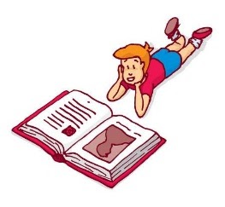
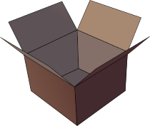
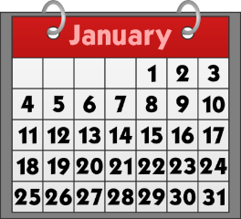
lista
libro
i
[book]
idea
interessante
primo
[first]
in
Notes:
Timing: 2 minutes
Aim: To introduce SSC [l]
Procedure:
Introduce and elicit the pronunciation of the individual SSC [i] and then the source word again ‘idea’ (with gesture, if using).
Then present and elicit the pronunciation of the five cluster words.
The cluster words have been chosen for their high-frequency, from a range of word classes, with the SSC (where possible) positioned within a variety of syllables within the words (e.g. initial, 2nd, final etc.). Additionally, we have tried to use words that build cumulatively on previously taught SSCs (see the Phonics Teaching Sequence document) and do not include new SSCs. Where new SSCs are used, they are often consonants which have a similar symbol-sound correspondence in English.
Word frequency (1 is the most frequent word in Spanish): libro [230]; salir [114]; lista [1189]; luego [150]; palabra [192]; luz [278] Source: Davies, M. & Davies, K. (2018). A frequency dictionary of Spanish: Core vocabulary for learners (2nd ed.). Routledge: London

Slide 4
lista
libro
i
idea
interessante
primo
in
Notes:
Without the images or sound, students have to pronounce the words themselves.

Slide 5
fonetica
leggere / parlare
libro
60
in
primo
idea
secondi
lista
interessante
0
INIZIO
Notes:
Phonics practice activity (we recommend doing either this or the next activity)
Timing: 1 minute
Aim: to gain confidence and fluency in saying words with [i]
Procedure:
1. Pupils say the words alternately out loud with a partner, building up speed, over 1 minute’s intensive practice.
2. Pupils call in any order they like, but are not allowed to repeat the one they said in their last turn. 3. Teacher can circulate to listen into their SSC knowledge.
Click on INIZIO to start a one minute timer on the screen.
Word frequency (1 is the most frequent word in Spanish): salir [114]; lista [1189]; palabra [192]; luz [278]; llamar [122]; llevar [101]; ella [72]; amarillo [1381]
Source: Davies, M. & Davies, K. (2018). A frequency dictionary of Spanish: Core vocabulary for learners (2nd ed.). Routledge: London

Slide 6
fonetica
leggere / parlare
60
libro
in
primo
secondi
idea
lista
0
interessante
INIZIO
Notes:
OPTIONAL
Phonics practice activity: alphabetical read aloud
Timing: 1 minute
Aim: to gain confidence and fluency in saying words with [i]
Procedure:
1. Individually (but all at once) pupils read out the words but in alphabetical order. They keep going for one minute.
2. Teacher can circulate to listen into their SSC knowledge.
Word frequency (1 is the most frequent word in Spanish): salir [114]; lista [1189]; palabra [192]; luz [278]; llamar [122]; llevar [101]; ella [72]; amarillo [1381]
Source: Davies, M. & Davies, K. (2018). A frequency dictionary of Spanish: Core vocabulary for learners (2nd ed.). Routledge: London

