Slide 1
Ripasso - Phonics - Unità 1
Spell the following words: (Ext. What do they mean in English?)
alto
una
male
carta
casa
amare
agosto
Notes:
Teacher says the word students write it down (on mini whiteboards?) check after each word and correct misspellings
1 alto
2 una
3 male
4 carta
5 casa
6 amare
7 agosto

Slide 3
e
elefante

Slide 4
questo
(this)
senza ketchup
senza
letto
avere
(to have)
essere
(to be)

Slide 5
questo
senza
letto
avere
essere

Slide 6
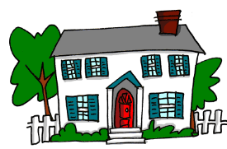
Write down the Italian word that has the SSC e
O
c_____
etto
asa
l______

Slide 7
Write down the Italian word that has the SSC e
(this)
O
qu____
arta
esto
c____

Slide 8
Write down the Italian word that has the SSC e
O
ene
b______
a_____
gosto

Slide 9
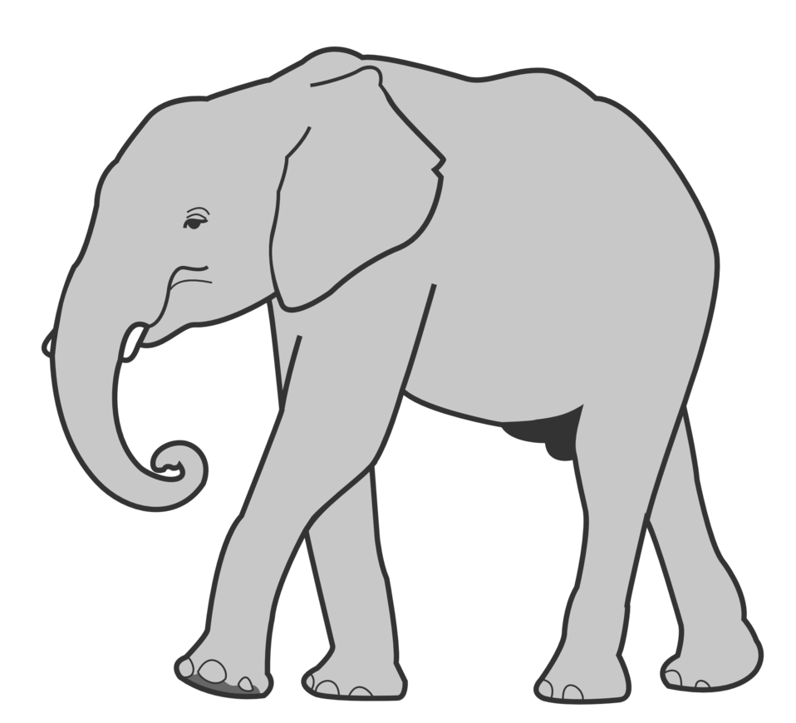
Write down the Italian word that has the SSC e
O
male
elefante

