Slide 1
Ripasso - Phonics
Spell the following words: (Ext. What do they mean in English?)
ragno
montagna
bagno
disegno
Spagna
giugno
Notes:
Teacher says the word students write it down (on mini whiteboards?) check after each word and correct misspellings
che?
chiesa
chiave
perché
chiamare
chiaro

Slide 2
SSC double consonants

Slide 3
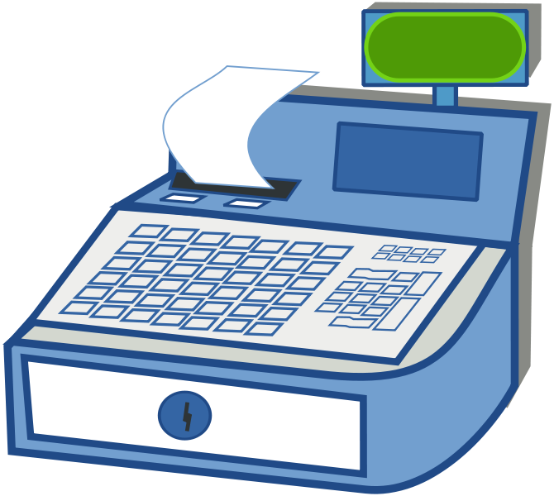
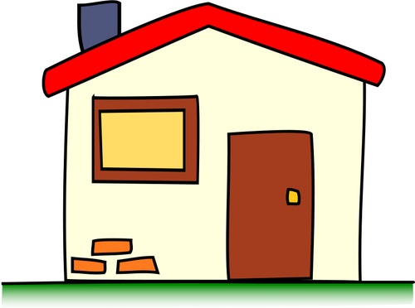
SSC double consonants
Double consonants in Italian are pronounced much more forcefully than a single consonant. The easiest way to do this is to shorten the vowel sound which comes before them. Compare these words below.
ss
s
cassa
casa

Slide 4
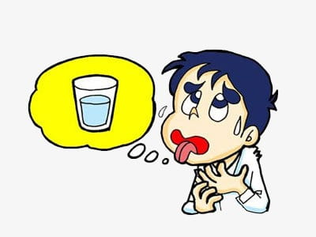
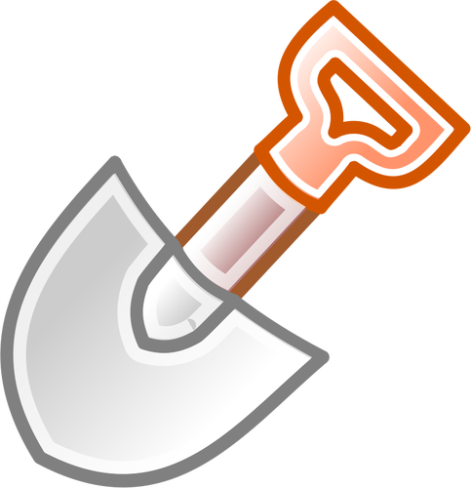
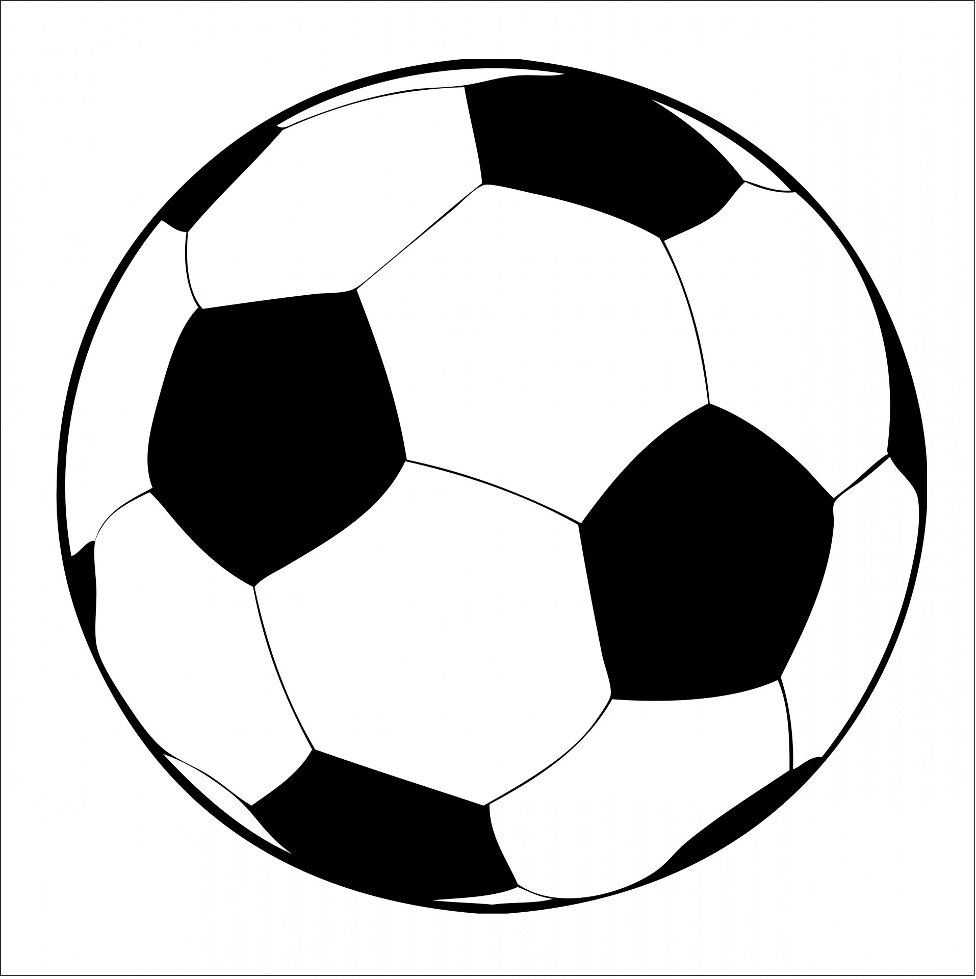
sette
sete
vs
palla
pala

Slide 5
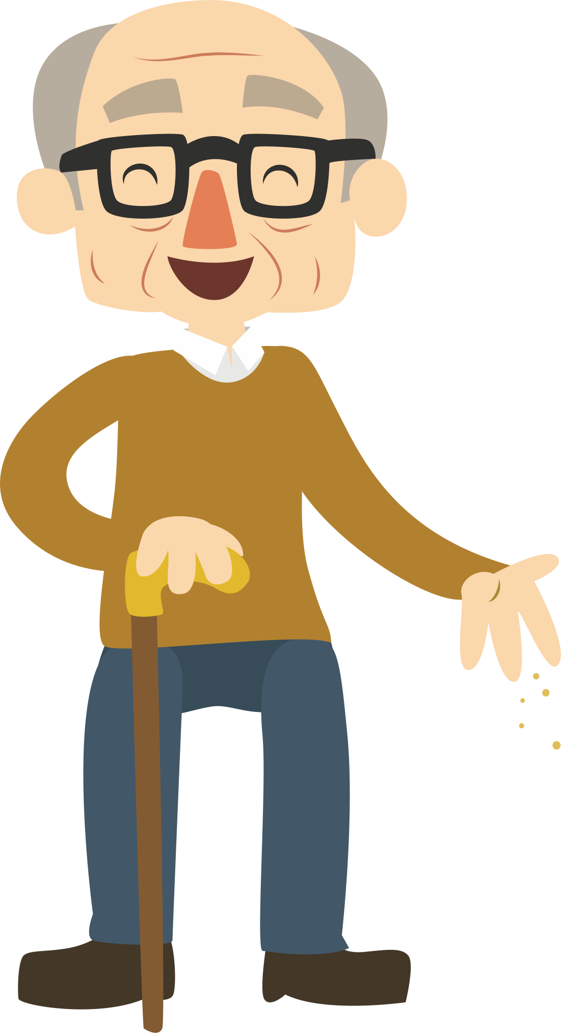
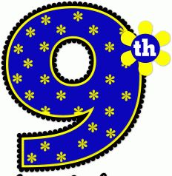
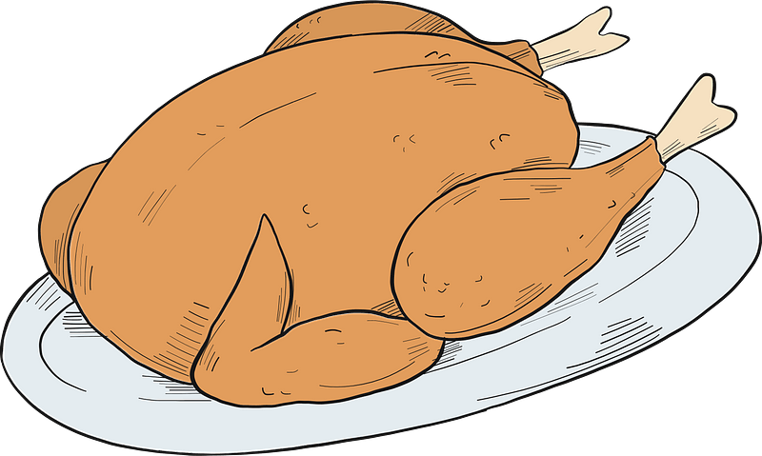
nonno
nono
vs
pollo
polo

Slide 6
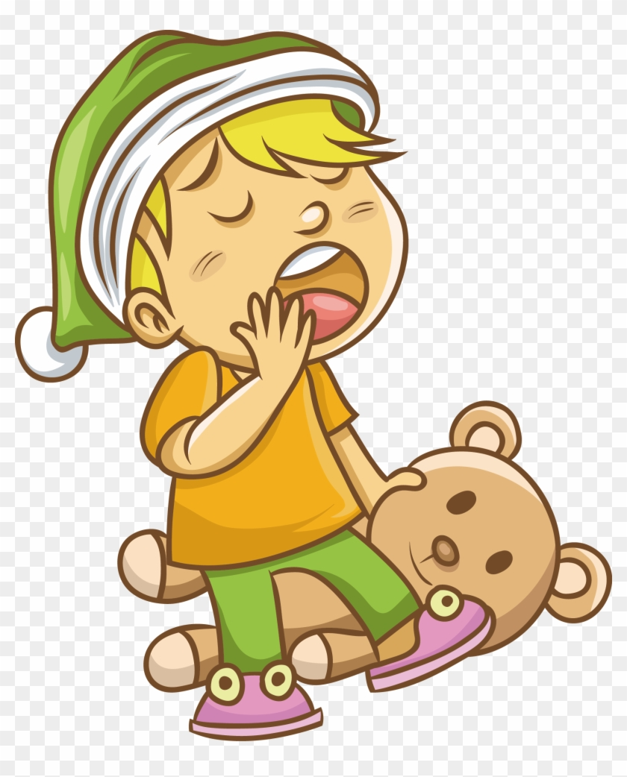
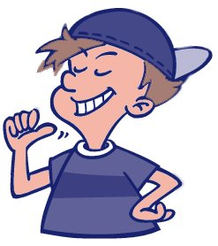
vs
sonno
sono

Slide 7
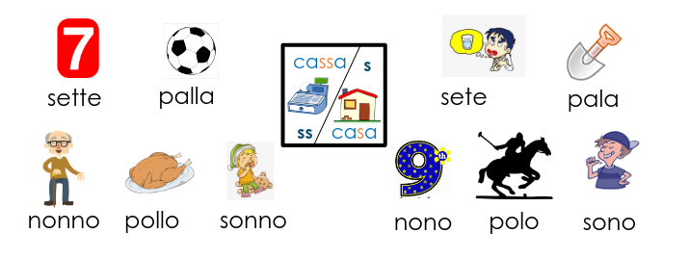
fonetica
leggere / parlare
Practise these words out loud. Remember, a double consonant requires a more forceful sound and a shorter vowel sound before it.
60
secondi
0
INIZIO
Notes:
Phonics practice activity (we recommend doing either this or the next activity)
Timing: 1 minute
Aim: to gain confidence and fluency in saying words with [i]
Procedure:
1. Pupils say the words alternately out loud with a partner, building up speed, over 1 minute’s intensive practice.
2. Pupils call in any order they like, but are not allowed to repeat the one they said in their last turn. 3. Teacher can circulate to listen into their SSC knowledge.
Click on INIZIO to start a one minute timer on the screen.
Word frequency (1 is the most frequent word in Spanish): salir [114]; lista [1189]; palabra [192]; luz [278]; llamar [122]; llevar [101]; ella [72]; amarillo [1381]
Source: Davies, M. & Davies, K. (2018). A frequency dictionary of Spanish: Core vocabulary for learners (2nd ed.). Routledge: London

