Slide 1
Ripasso - Phonics
Spell the following words: (Ext. What do they mean in English?)
aglio
famiglia
luglio
foglia
biglietto
bottiglia
Notes:
Teacher says the word students write it down (on mini whiteboards?) check after each word and correct misspellings
che?
chiesa
chiave
perché
chiamare
chiaro

Slide 2
SSC gn

Slide 3
gn
ragno

Slide 4
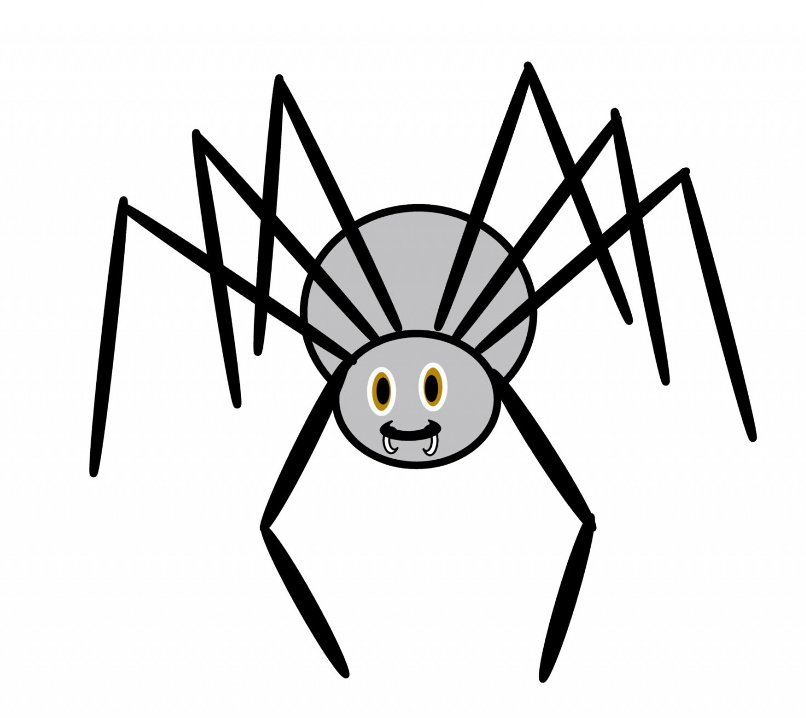
gn
ragno

Slide 5
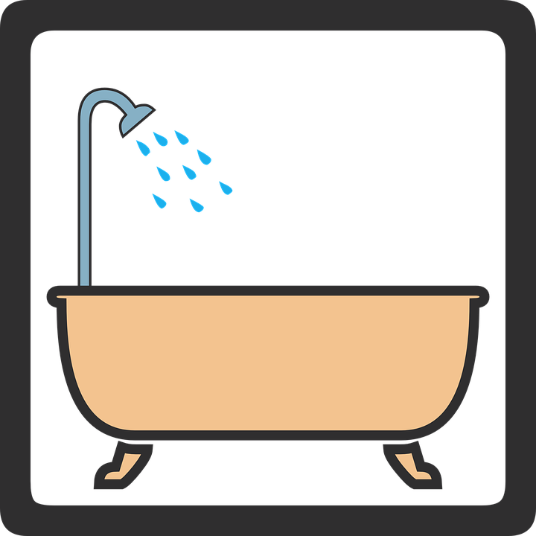
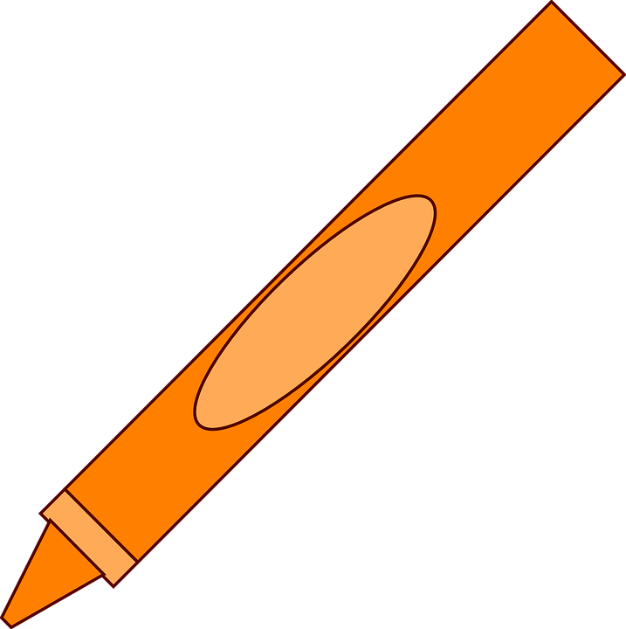
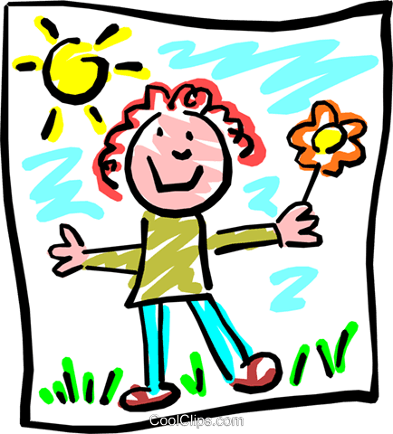
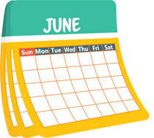
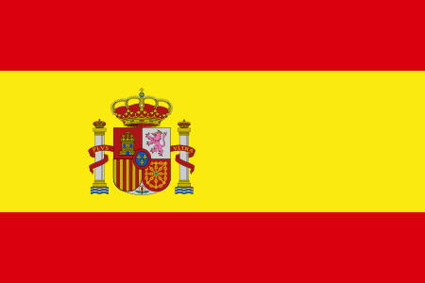
montagna
bagno
disegno
Spagna
giugno

Slide 6
montagna
bagno
disegno
Spagna
giugno

Slide 8
fonetica
leggere / parlare
disegno
60
ragno
montagna
secondi
giugno
bagno
0
Spagna
INIZIO
Notes:
Phonics practice activity (we recommend doing either this or the next activity)
Timing: 1 minute
Aim: to gain confidence and fluency in saying words with [i]
Procedure:
1. Pupils say the words alternately out loud with a partner, building up speed, over 1 minute’s intensive practice.
2. Pupils call in any order they like, but are not allowed to repeat the one they said in their last turn. 3. Teacher can circulate to listen into their SSC knowledge.
Click on INIZIO to start a one minute timer on the screen.
Word frequency (1 is the most frequent word in Spanish): salir [114]; lista [1189]; palabra [192]; luz [278]; llamar [122]; llevar [101]; ella [72]; amarillo [1381]
Source: Davies, M. & Davies, K. (2018). A frequency dictionary of Spanish: Core vocabulary for learners (2nd ed.). Routledge: London

