Slide 1
Ripasso - Phonics
Spell the following words: (Ext. What do they mean in English?)
spaghetti
tartarughe
portoghese
funghi
ghiaccio
colleghi
Notes:
Teacher says the word students write it down (on mini whiteboards?) check after each word and correct misspellings
che?
chiesa
chiave
perché
chiamare
chiaro

Slide 2
SSC gl

Slide 3
gl
aglio

Slide 4
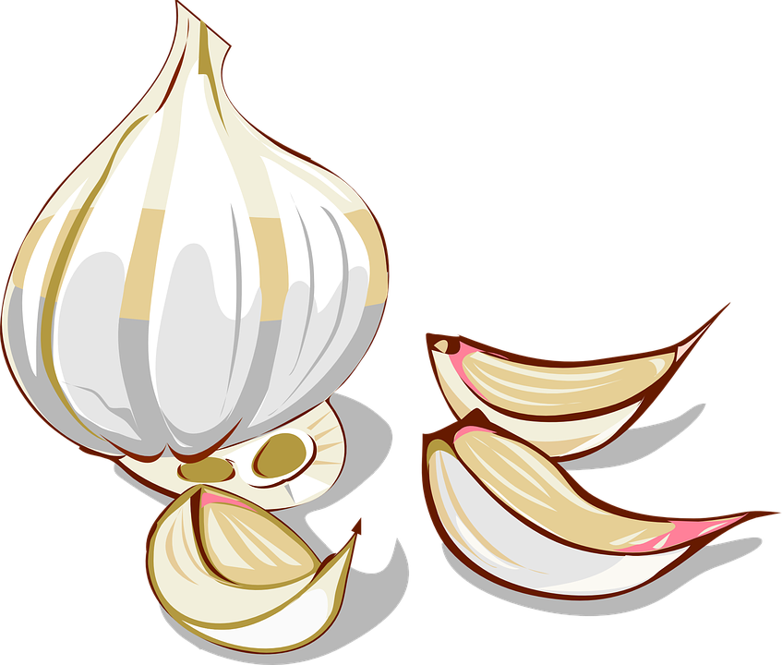
gl
aglio
aglio

Slide 5
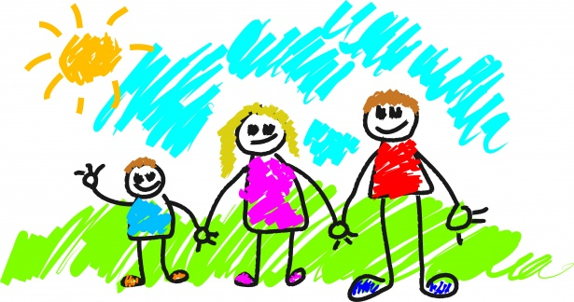
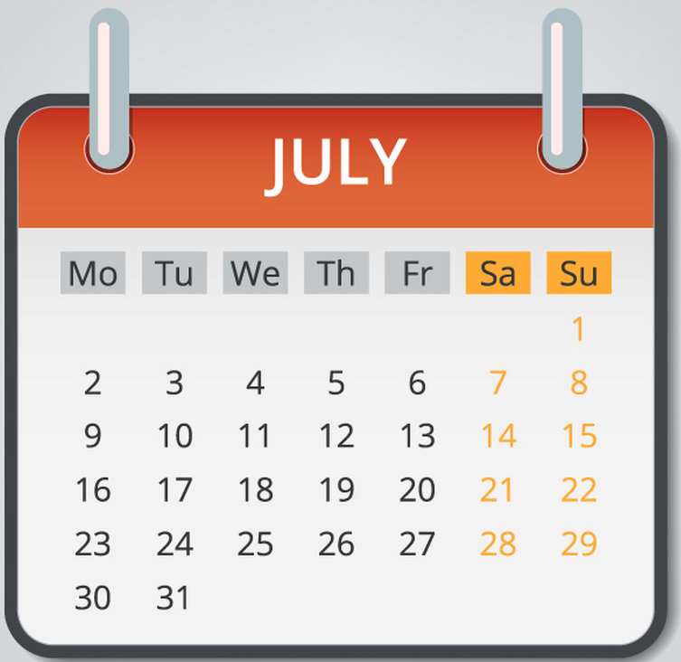
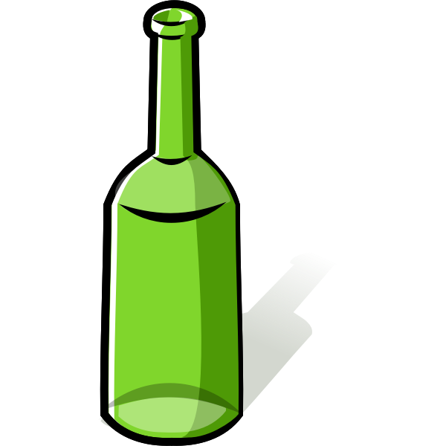
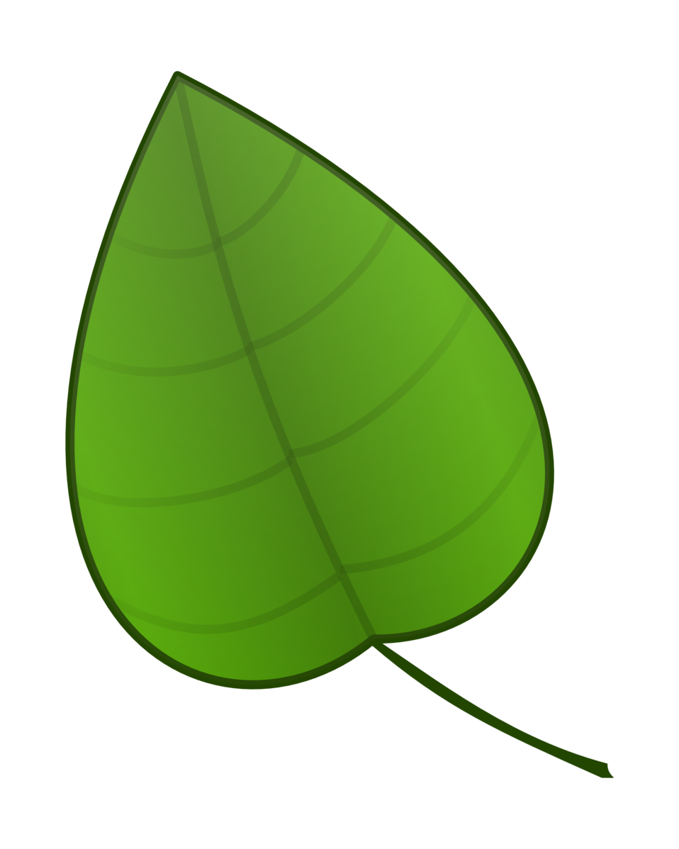
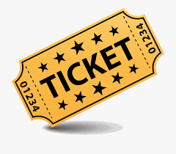
familglia
luglio
bottiglia
foglia
biglietto

Slide 6
familglia
luglio
bottiglia
foglia
biglietto

Slide 7
fonetica
leggere / parlare
famiglia
60
luglio
bottiglia
secondi
foglia
biglietto
0
INIZIO
Notes:
Phonics practice activity (we recommend doing either this or the next activity)
Timing: 1 minute
Aim: to gain confidence and fluency in saying words with [i]
Procedure:
1. Pupils say the words alternately out loud with a partner, building up speed, over 1 minute’s intensive practice.
2. Pupils call in any order they like, but are not allowed to repeat the one they said in their last turn. 3. Teacher can circulate to listen into their SSC knowledge.
Click on INIZIO to start a one minute timer on the screen.
Word frequency (1 is the most frequent word in Spanish): salir [114]; lista [1189]; palabra [192]; luz [278]; llamar [122]; llevar [101]; ella [72]; amarillo [1381]
Source: Davies, M. & Davies, K. (2018). A frequency dictionary of Spanish: Core vocabulary for learners (2nd ed.). Routledge: London

