Slide 1
Ripasso - Phonics
Spell the following words: (Ext. What do they mean in English?)
leggere
gelato
gente
oggi
pagina
viaggi
Notes:
Teacher says the word students write it down (on mini whiteboards?) check after each word and correct misspellings
che?
chiesa
chiave
perché
chiamare
chiaro

Slide 2
SSC ghe / ghi

Slide 3
ghe
spaghetti

Slide 4
ghi
funghi

Slide 5
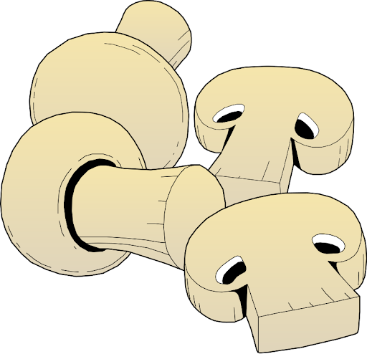
spaghetti
ghi
ghe
funghi
spaghetti
funghi

Slide 6
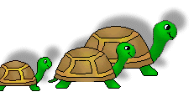
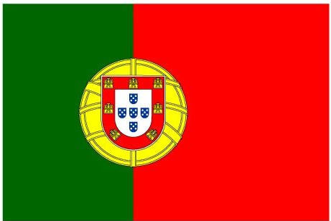
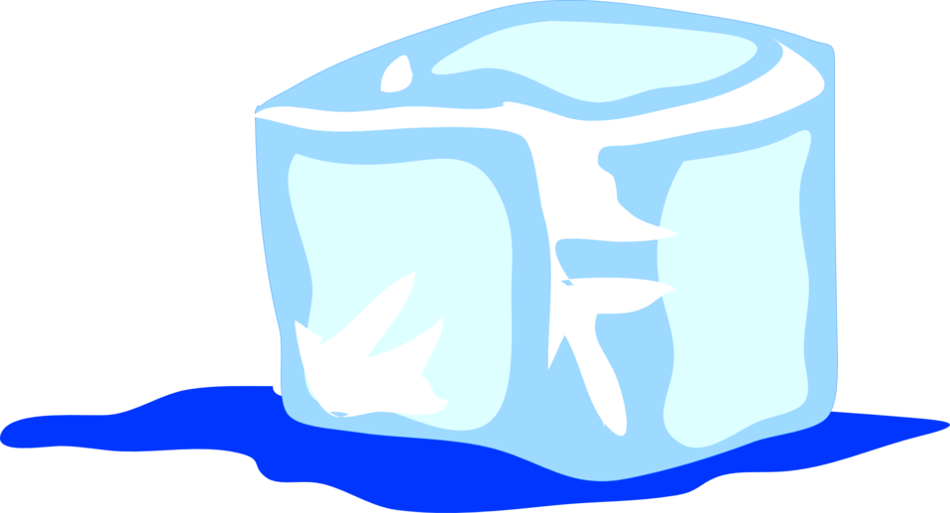
tartarughe
portoghese
[colleagues]
ghiaccio
colleghi

Slide 7
tartarughe
portoghese
ghiaccio
colleghi

Slide 8
Write down the Italian word that has the SSC ghe
O
ghi
ghe
fun___
porto___se

Slide 9
Write down the Italian word that has the SSC ghi
O
ghi
__accio
tartaru____
ghe

Slide 10
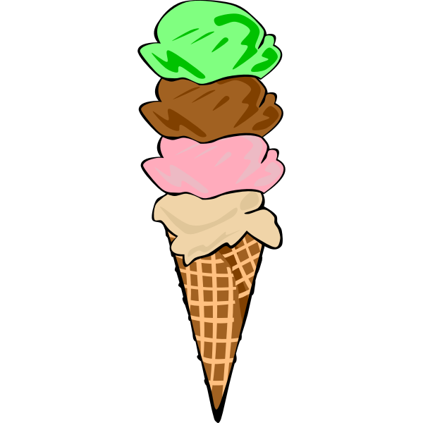
Write down the Italian word that has the SSC ghe
O
ge
ghe
___lato
spa____tti

