Slide 1
Ripasso - Phonics
Spell the following words: (Ext. What do they mean in English?)
sciarpa
piscina
scienza
pesce
scena
scelta
Notes:
Teacher says the word students write it down (on mini whiteboards?) check after each word and correct misspellings
che?
chiesa
chiave
perché
chiamare
chiaro

Slide 2
C’è there is
SSC ga / go / gu

Slide 3
ga
gatto

Slide 4
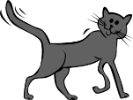
gatto

Slide 5
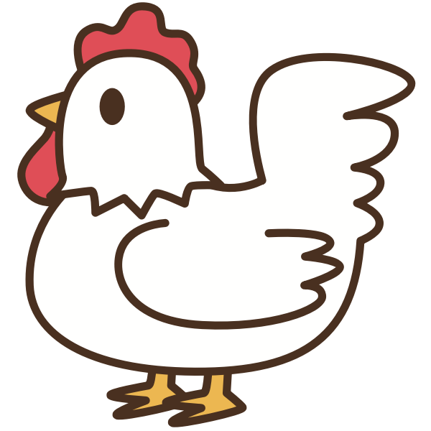
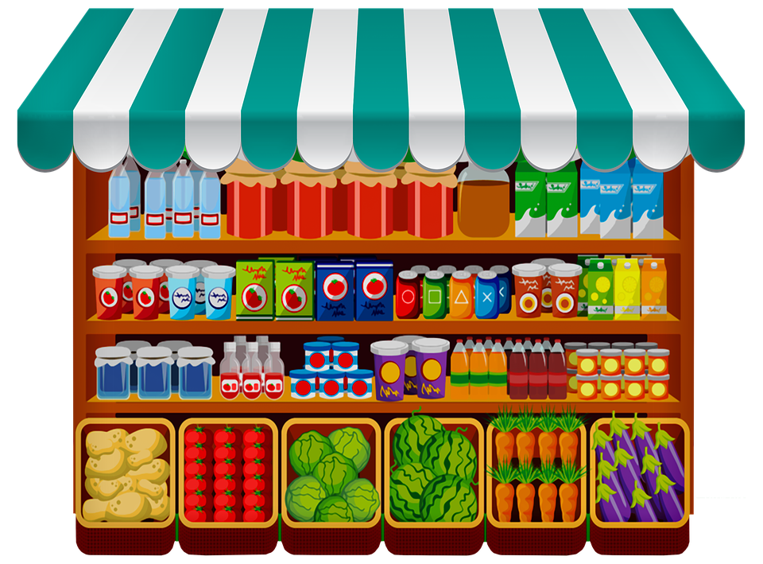
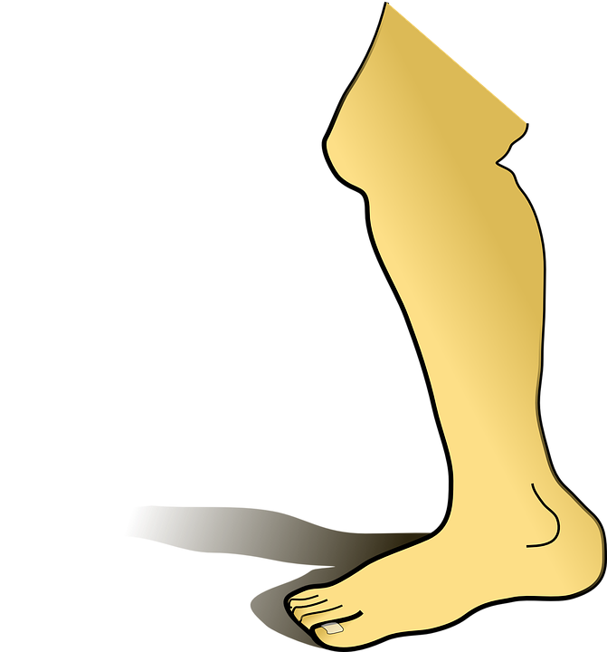
gallina
regalo
bottega
[to pay]
gamba
pagare

Slide 6
gatto
gallina
regalo
bottega
gamba
pagare

Slide 7
go
gonna

Slide 8
gonna

Slide 9
[long]
lungo
golf
luogo
[place]
gomma
lago

Slide 10
lungo
gonna
golf
luogo
gomma
lago

Slide 11
gu
gusto

Slide 12
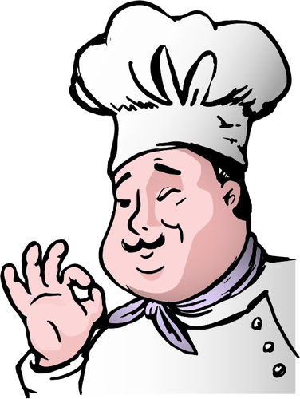
[figure,
shape]
gusto
figura

Slide 13
Gu + a/e/i
gua / gue / gui

Slide 14
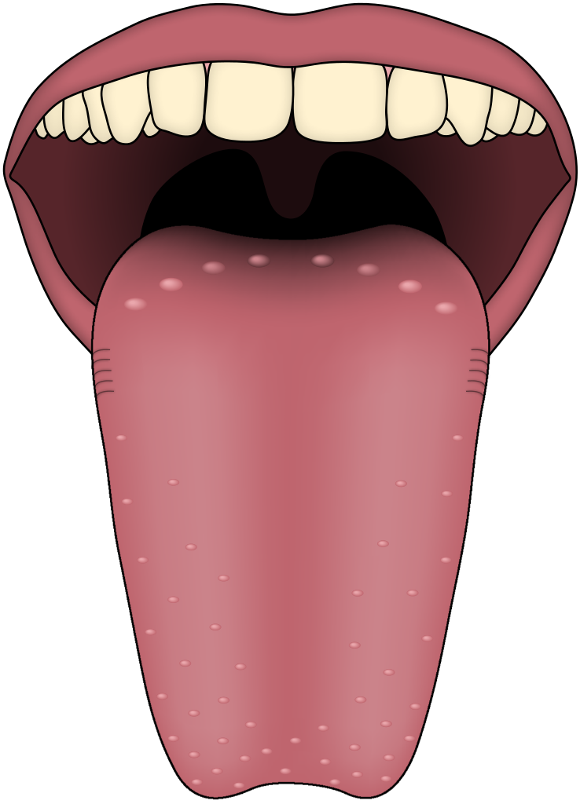
guidare
guerra
[to watch]
guardare
lingua

Slide 15
guidare
guerra
guardare
lingua

Slide 16
Write down the Italian word that has the SSC gua
O
lin ____
gua
ga
__tto

Slide 17
Write down the Italian word that has the SSC gue
O
____nna
go
gue
___rra

Slide 18
Write down the Italian word that has the SSC gui
O
gu
gui
____sto
___dare

Slide 19
Write down the Italian word that has the SSC ga
O
ga
ga
___mba
botte___

