Slide 1
Carole Moore Derek Aust
Second Edition

Slide 2
Why a second edition?
What needed updating?
What have we changed?
What elements have we kept?

Slide 3
Why a second edition?
Much of Amici was still valid as a teaching tool for ab initio use, but …
Examination requirements have changed since the first edition
Certain sections of Amici needed to be updated

Slide 4
What needed updating?
We needed to:
Update the Ripasso & Progetto sections
Update Chapter 19
Update some photos & illustrations
Add some extracts from literature
Add some translation exercises
Add a few extra grammar explanations

Slide 5
What have we changed?
Ripasso pages:
Listening and Reading (1 page each)
Writing and Speaking (2 Page spread each)
Grammatica sections have rubrics in English.
We have added: the Future and Conditional Perfect
‘si’ + plural adjective
We have added:
extracts from literature and
translation exercises
We have updated:
photos (including the characters) illustrations
Chapter 19

Slide 6
What elements have we kept?
The Listening recordings and transcripts
The topic layout
The majority of the grammar explanations and Grammatica pages
The storyline of the characters
The book is still based in and around Florence

Slide 7
So what’s new?
Here are some of the changes

Slide 8
Lettura 1
Still the Amici Chat page, but with:
Updated photos
New character – Daniela
New Traduci in italiano exercise
My name is Lorenzo. I play football with my friends once a week. I go to the swimming baths every Friday with my brother Gino. I go to the cinema often. I like detective films.
N.B. All of this vocabulary occurs in the previous chapters and by translating this short item and reading the page, students should be able to write their own short message, using the present tense.

Slide 9
19.2
Le stragi del sabato sera
Chapter 19 has been updated with some new texts
Here a grammatica box and exercise on the pronoun si + an adjective has been added
A translation on ‘today’s homeless’ has been added

Slide 10
Grammatica 5
Still the same helpful blue Grammatica summaries but with:
Exercise rubrics in English
Grammar pages updated to include the Future Perfect and the Conditional Perfect
Grammar Summary at back of book also updated to include these tenses

Slide 11
Ripasso 1
Come leggere
Still same style – one page: Come leggere
An updated aiuto section
Questions in Italian and English
A short translation into English
2 is a short summary in Italian of Il Barone Rampante by Italo Calvino with a translation into English and a comprehension exercise
N.B. As this is the first time students are faced with literature and it is quite early in the book, we thought this would be a gentler introduction to reading literary extracts.

Slide 12
Ripasso 1 Come scrivere
New 2 page spread
Foundation style on left
Higher style on right
Aiuto boxes for guidance with tasks
As we are still near the beginning of the book this Ripasso uses only the Present tense
Sample answers in Teacher Handbook

Slide 13
Ripasso 1
Come scrivere
In Ripasso 1 the Aiuto boxes give clear advice on how to tackle each task

Slide 14
Ripasso 1
Come parlare
New 2 page spread
Aiuto and Ricorda boxes for helpful advice
Upside down Teacher/Partner Role
Upside down unprepared questions for Photocard
Sample answers for Role Plays, Photo Cards and General Conversation questions in Teacher Handbook

Slide 15
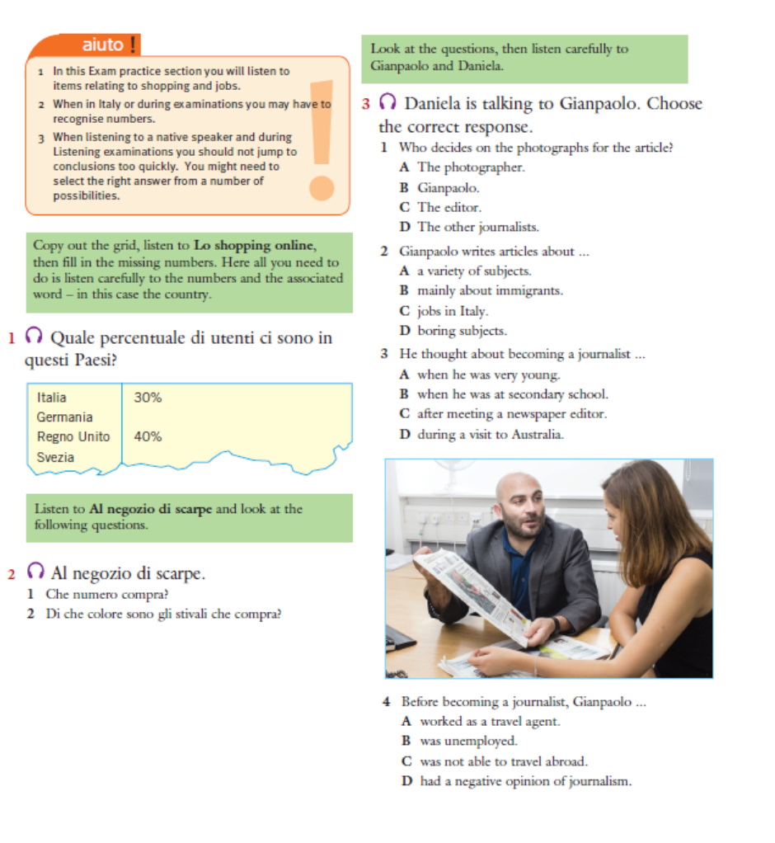
Ripasso 3
Come ascoltare
Still same style – one page: Come ascoltare
Still same recording
An updated photo
Questions in Italian and English
Ex 3 changed to questions in English

Slide 16
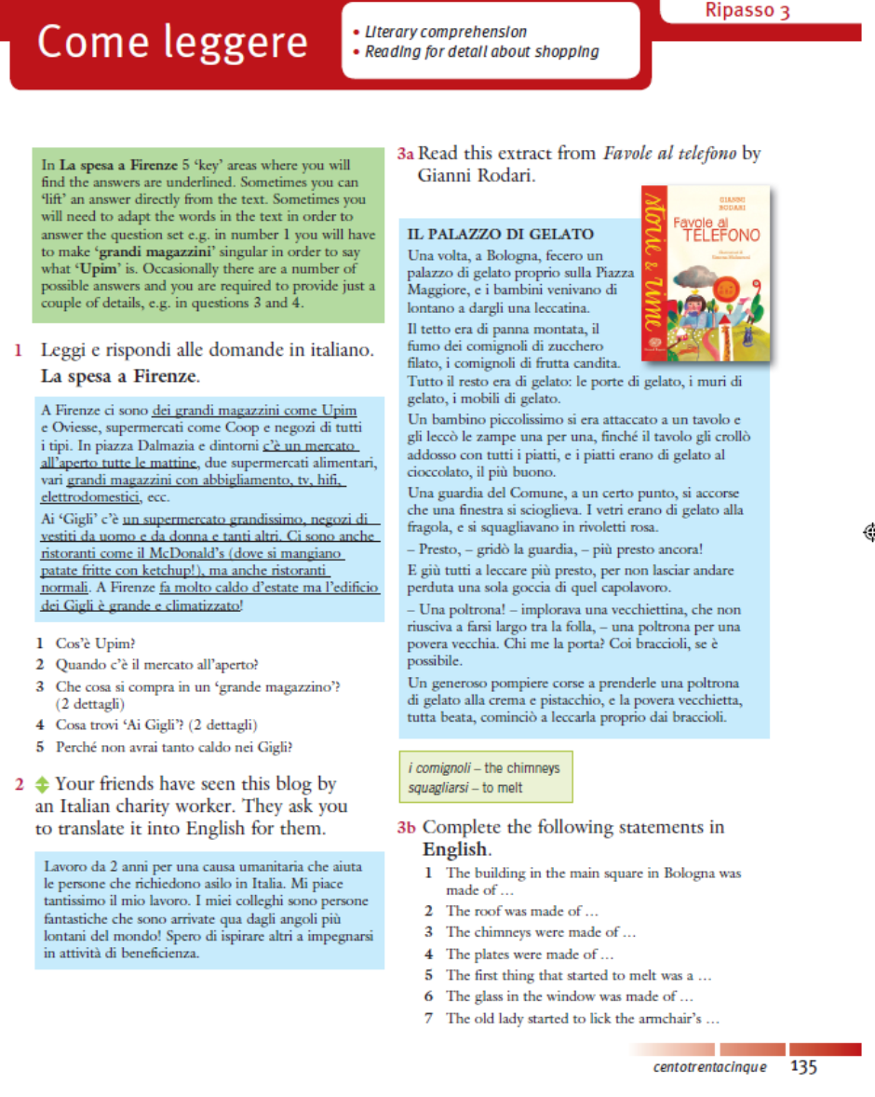
Ripasso 3
Come leggere
Same text on La spesa a Firenze
New translation from Italian (about working as a volunteer)
New extract from Favole al telefono by Gianni Rodari with questions in English

Slide 17
Teacher Handbook
Ripasso 3
Teacher handbook fully updated to incorporate changes to Student Book
Example on the right shows answers to Ripasso 3 Come leggere Translation Exercise as well as sample answers to the new Come parlare and Come scrivere sections.
It also gives a little detail about Favole al telefono
‘… Favole al telefono. Gianni Rodari (1920-1980) is widely considered to be the most influential Italian children’s author of the 20th century. … Every night at 9.00 p.m., a father travelling through Italy for work rings his little daughter and tells her a bedtime story. His stories are so heart-warming that even the telephone operators stop to listen.’

Slide 18

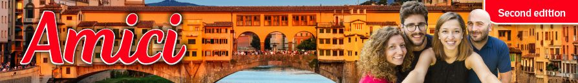
Want to know more?
This is the link to the OUP Amici page:
https://global.oup.com/education/content/secondary/series/amici-2nd-edition/?region=uk

