Slide 1
venerdì venti marzo Titolo: In vacanza ho visitato LO: To say what you did on holiday
STARTER: Can you remember how to form the perfect tense in Italian?
Notes:
9y 3.10

Slide 2
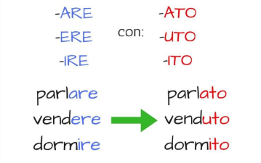
“PASSATO PROSSIMO” (= near past) is the most used PAST TENSE in Italian and it’s used to describe things done in the past.
Eg: HO FINITO = I have finished / SONO ANDATO = I have been
Take off - Add
Conjugated for of
Auxiliary
ESSERE /AVERE
+ PAST PARTICIPLE
of the main VERB
Esempi:
Actions
involving
movement
All other
actions

Slide 3
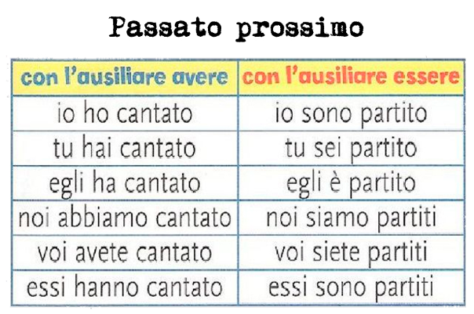
EXTENTION: FULL CONJUGATION

Slide 4
ESEMPI: Conjugate into the perfect tense
ESEMPIO: I have travelled (VIAGGIARE) = ho viaggiato
I have eaten (MANGIARE) =
We have bought (COMPRARE) =
We have been (ANDARE) =
I have swam (NUOTARE) =
* I have done (FARE) =
* I have seen (VEDERE) =
* I have read (LEGGERE) =

Slide 5
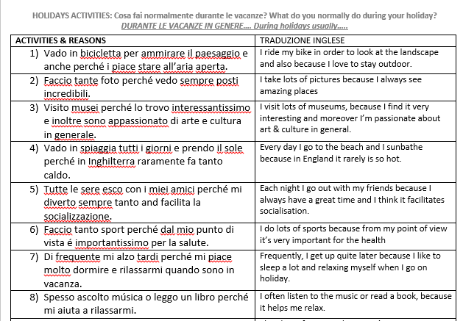
NOW REFER TO LAST LESSON’S HANDOUT: Highlight all the present tenses and changed them into PASSATO PROSSIMO
ESEMPIO:
Sono andato in bicicletta = I rode my bike

