Slide 1
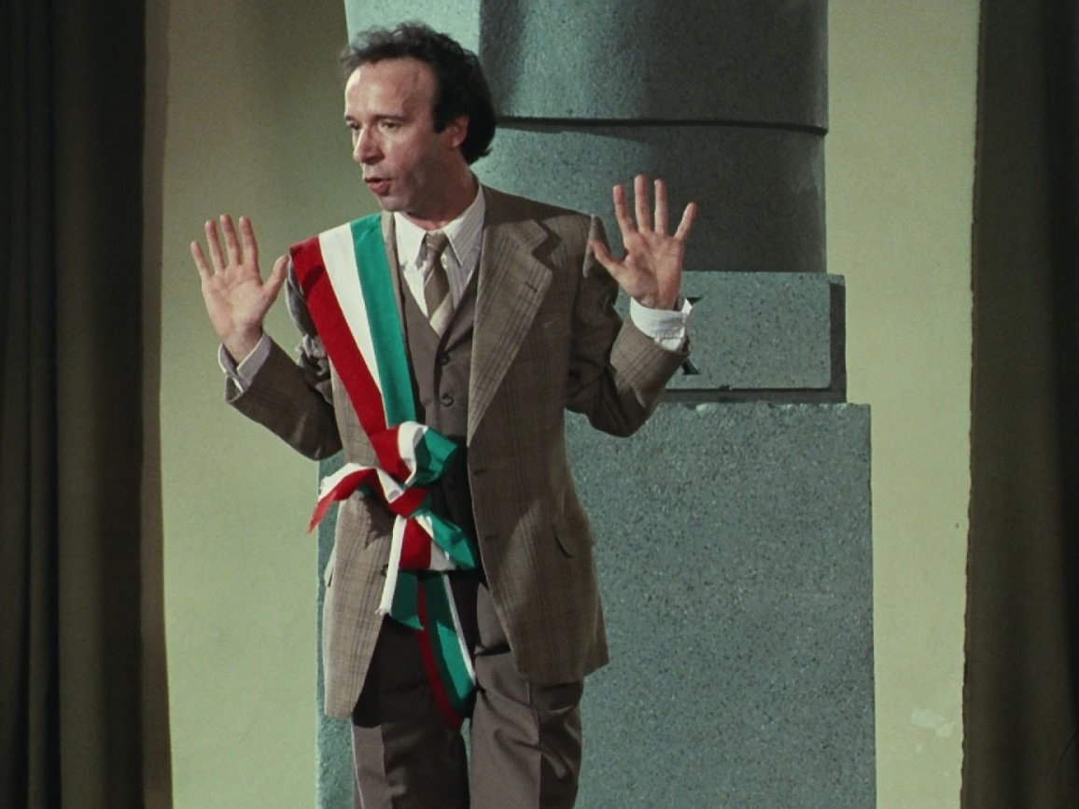
Approaches to teaching La vita è bella
By Charles L. Leavitt IV
Italian Teachers Day

Slide 2
“I can't help feeling we've turned a corner in the way we think about the Holocaust when a film this naively blundering can pass without question.”
“There's no doubt that La vita è bella is a sincere undertaking, but it's fundamentally mendacious—it presents the Holocaust as a gently touching tragedy with a happy ending, its horrors doused in a few cathartic tears. Its dramatic logic even implies that the horror really happened so that one man could become a hero.”
– Jonathan Romney, “Camping it up.” The Guardian 12 Feb. 1999.
“The enormous worldwide success of Life Is Beautiful suggests that the audience is exhausted by the Holocaust, that it is sick to death of the subject's unending ability to disturb. The audience's mood is understandable, but artists are supposed to be made of sterner stuff, and surely an artist cannot transcend what he never encounters.... Life Is Beautiful is a benign form of Holocaust denial. The audience comes away feeling relieved and happy and rewards Benigni for allowing it, at last, to escape.”
– David Denby, "In the Eye of the Beholder." The New Yorker 15 March 15 1999.

Slide 3
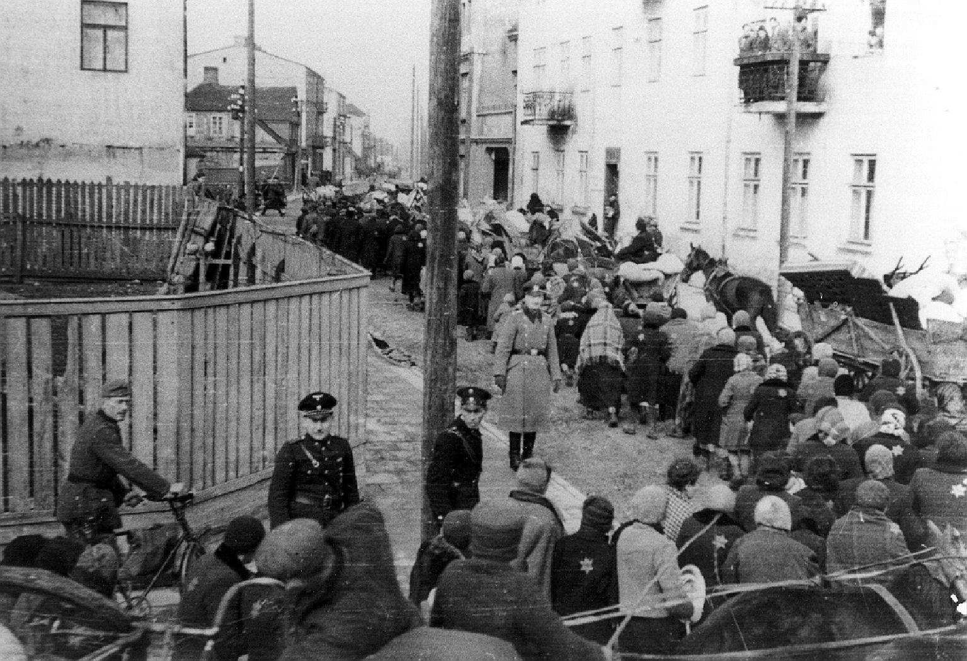
“For a culture that has lived, with knowledge of the Holocaust for over half a century, the danger of denial is accompanied by the equal danger of desensitization. As ‘realistic’ images of the Holocaust flood popular culture, there is a danger that the event will increasingly become identified with a series of commonly known historical facts and pictures, and hence lose its power to horrify. The distance that Benigni’s film maintains from realistic depictions of the Holocaust enables the directors to use history to remind the audience of the moral lessons that it contains. Guido’s protective conversations with his son awaken in the viewers the horror and disbelief that the Holocaust must continue to generate in a culture that has become so familiar with its basic facts and images.”
– Gefen Bar-on, “Benigni’s life-affirming lie: Life is Beautiful as an aesthetic and moral response to the Holocaust.” Beyond Life is Beautiful: Comedy and Tragedy in the Cinema of Roberto Benigni. Ed. Grace Russo Bullaro. (Troubador Publishing, 2005)

Slide 4
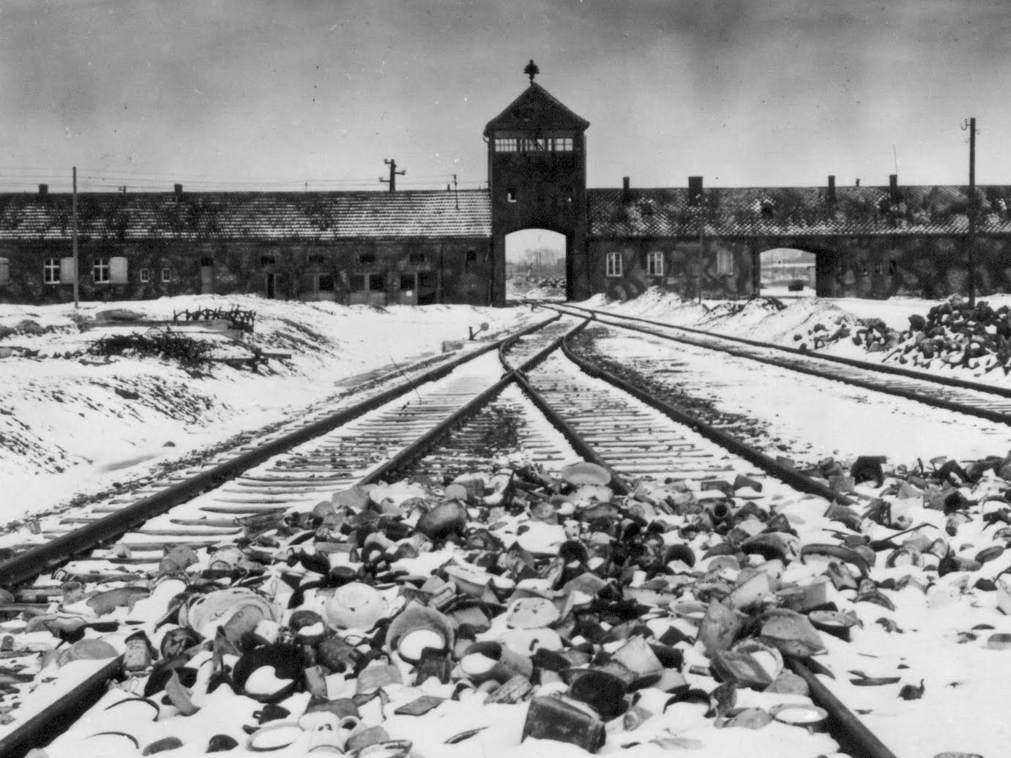
“‘the Holocaust,’ as we speak of it today, was largely a retrospective construction, something that would not have been recognizable to most people at the time. To speak of ‘the Holocaust’ as a distinct entity […] is to introduce an anachronism that stands in the way of understanding contemporary responses. The sheer number of victims of the Holocaust continues to inspire awe: between five and six million. But the Holocaust took place—we know this, of course, but we don’t often think of its implications—in the midst of a global war the eventually killed between fifty and sixty million people.”
– Peter Novick, The Holocaust in American Life

Slide 5
Nomos, “La guerra ci ha lasciato sottouomini mutilati dell’anima.” Oggi (25 Aug 1945)

Slide 6
“Ancora una testimonianza sull’orrido dei campi tedeschi di concentramento. Dopo Auswitz, Belsen, Dachau e minori, ecco Mauthausen, con le derivazioni di Gusen, Ebeusi, Melch.”
– Antonio Antonucci, “L’inferno di Mauthausen. Come morirono cinquemila italiani.” La Nuova Stampa 16 Dec. 1945:

Slide 7
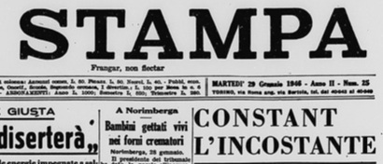
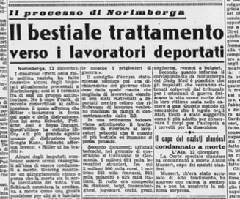
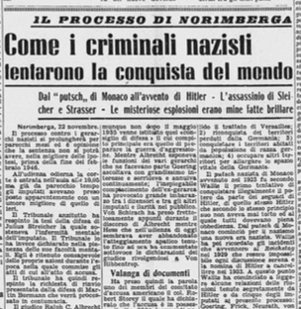
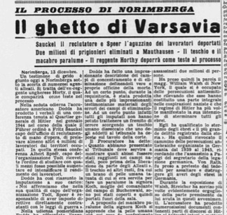
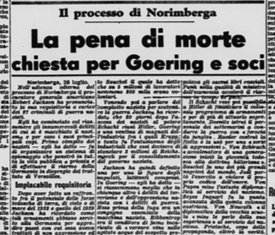
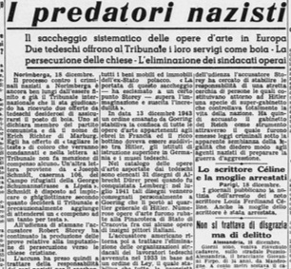
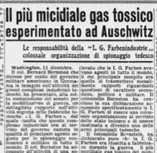
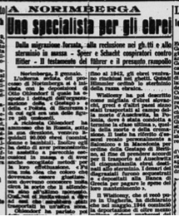
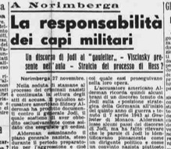
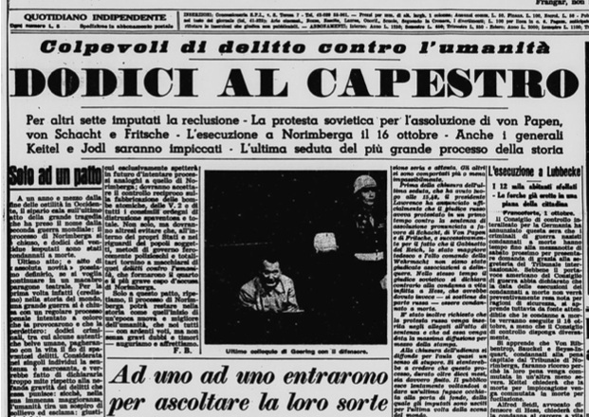
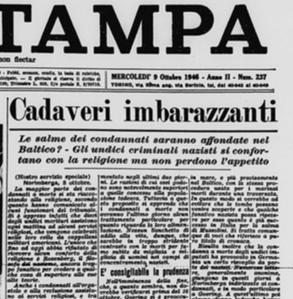
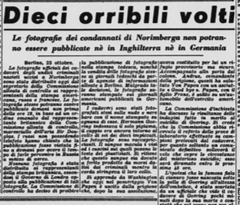
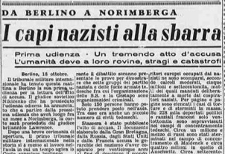
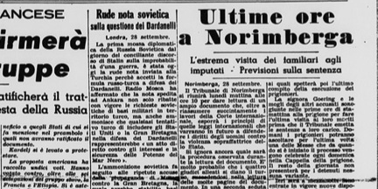
Notes:
Held between 20 November 1945 and 1 October 1946

Slide 9
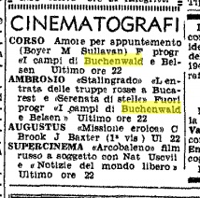

Slide 10
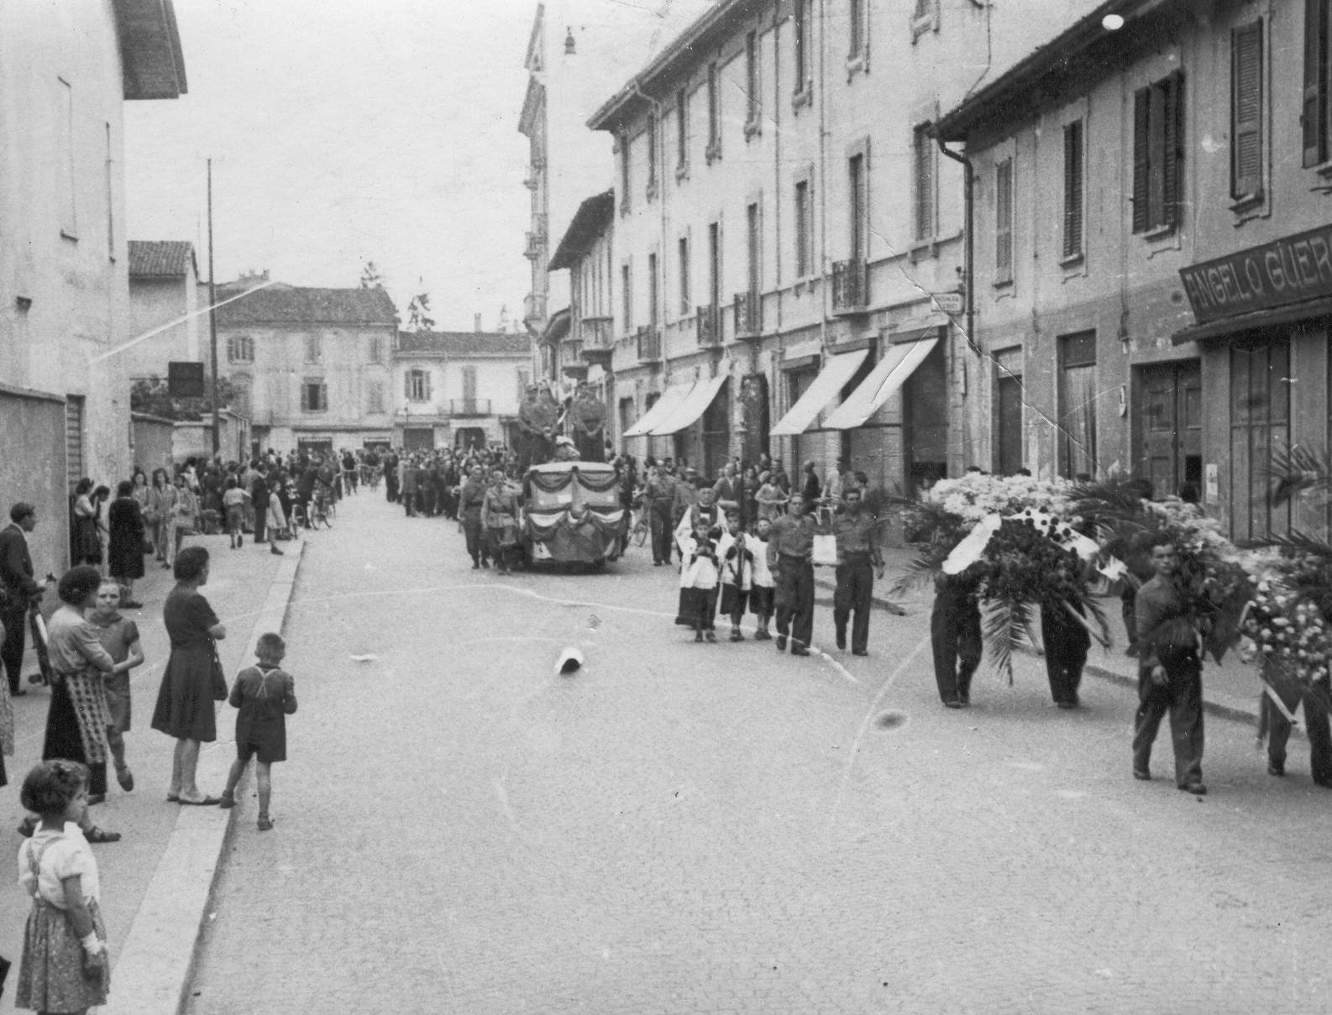
Emilio Cecchi, “Immagini dell’orrore.” Radiovoci 9 June 1945
“Non c’è dubbio che, in queste ultime settimane, quanto di meglio le sale cinematografiche potevano offrire al loro pubblico, era tutto come scancellato e annullato da quei terribili documentari delle atrocità scoperte dalle truppe di occupazione, a Buckenwald, Dachau, Belsen ed altri campi di concentramento.”
“Appunto perché l’Europa […] fu per secoli la più alta convivenza civile, ed a meno di perire deve tornare ad esserlo, in forme sempre più leali e più strette: era necessario che, in seno a tale convivenza, tutti conoscessero quali insuperate devastazioni materiali e morali il furore della guerra fu capace a produrre.”
“Sui limiti di questi eccessi bestiali, di questi orrori mostruosi, si può affacciarsi con l’occhio e con la mente; ma per subito ritrarsene. Non dimenticheremo più mai d’aver veduto queste opere dell’inferno e della notte: ma togliamone lo sguardo. Il mondo ha bisogno d’avviarsi finalmente ad uscire dagli incubi. E di ricominciare a respirare, e sperare.”

Slide 11
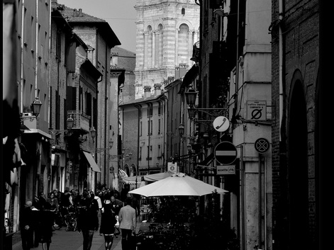
“Una lapide in via Mazzini”
“Lui era stato a Buchenwald e, unico!, ne tornava, dopo avere sopportato chissà quali torture del corpo e dello spirito, dopo aver assistito a chissà quali orrori. Ebbene essi erano lì, a sua disposizione, tutti orecchi per ascoltare.”

Slide 12
“Una lapide in via Mazzini”
“Non era possibile francamente – esclamavano –, tirare avanti una conversazione con un individuo travestito! E d’altra parte, a lasciarlo parlare lui – continuavano –, eccolo subito che ripigliava a raccontarti di Fòssoli, della Germania, di Buchenwald, della fine di tutti quanti i suoi, eccetera: da non saper più, a un dato momento, in che modo squagliarsela.”

Slide 13
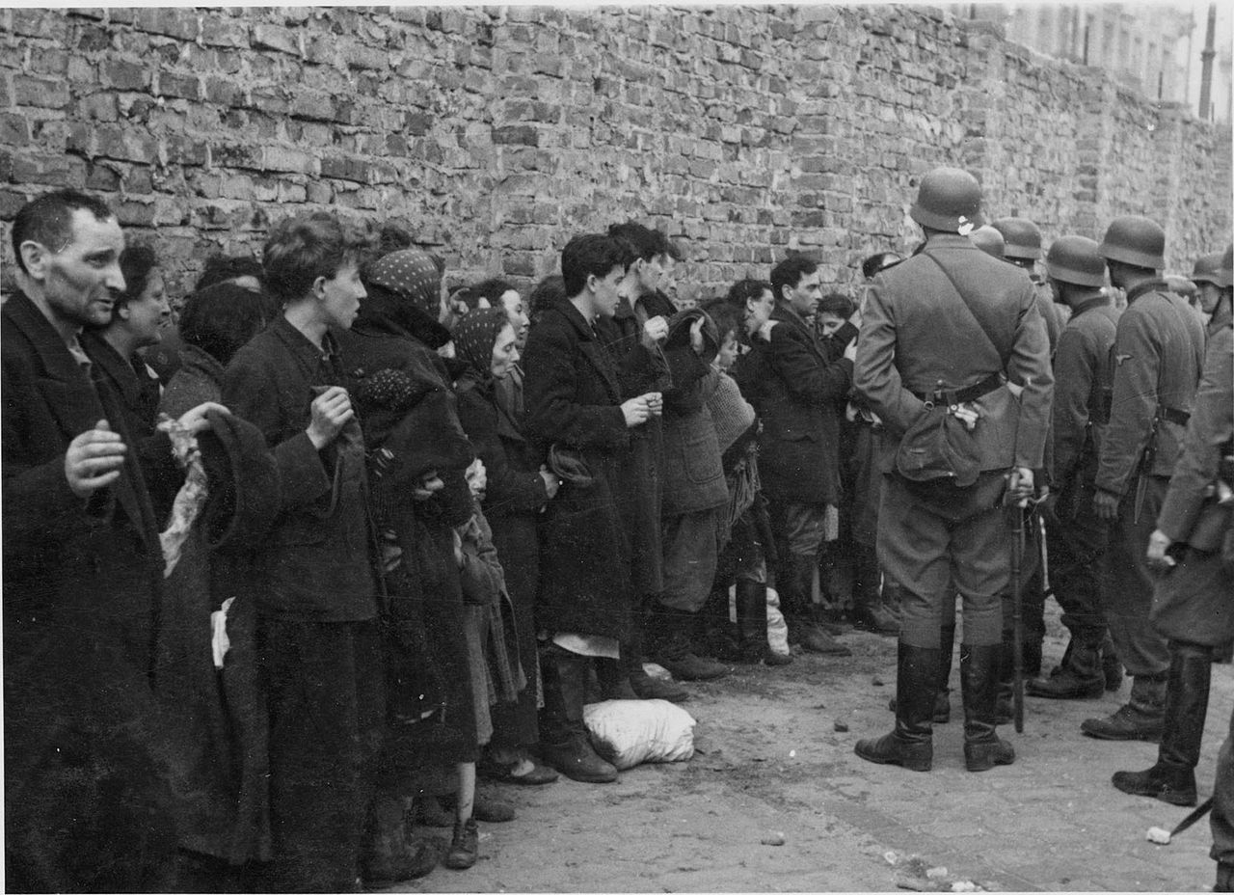
“If the purpose of Holocaust witness is dynamic transmission—the passing on of the testimony in a way that invests its receivers with the moral obligation to convey their knowledge to others—then the narrative must remain open to constant elaboration, adaptation, and rearticulation in ways that will recommend it to new generations of listeners. To insist on a documentary approach to the representation of the Holocaust is to consign it to the archives, to embalm and distance it in a way that will deprive the history of its urgent moral claim to our attention.”
– Millicent Marcus, After Fellini: National Cinema in the Postmodern Age. (The Johns Hopkins University Press, 2002)

Slide 14
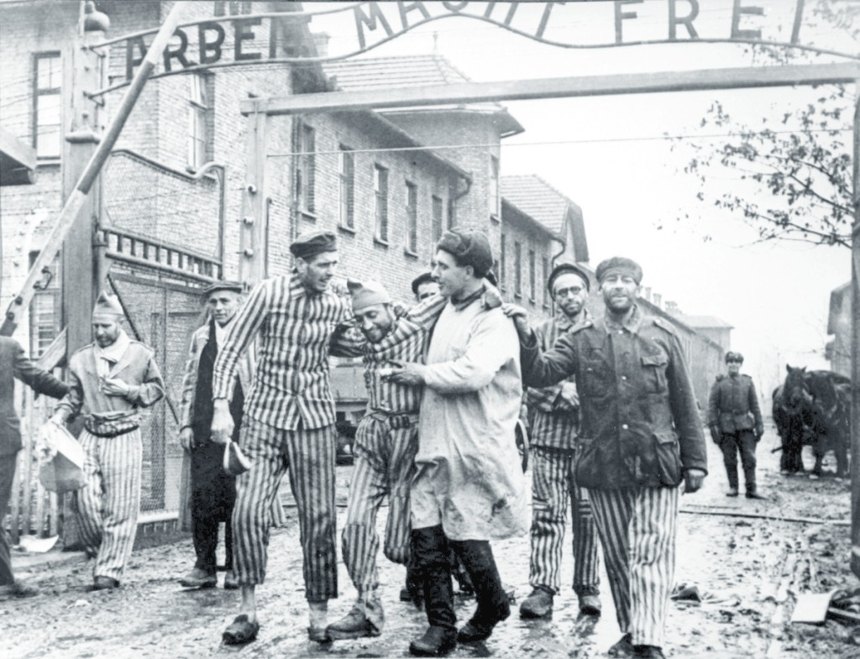
“As the father carries his sleeping son back to their barracks in the night and fog, what appears to be a mass grave full of twisted corpses opens behind them. In this brief, wordless scene, Guido is confronted with the ultimate signified of the Holocaust, the referent that all his machinations have sought to mask.”
– Millicent Marcus, After Fellini: National Cinema in the Postmodern Age. (The Johns Hopkins University Press, 2002)

Slide 15
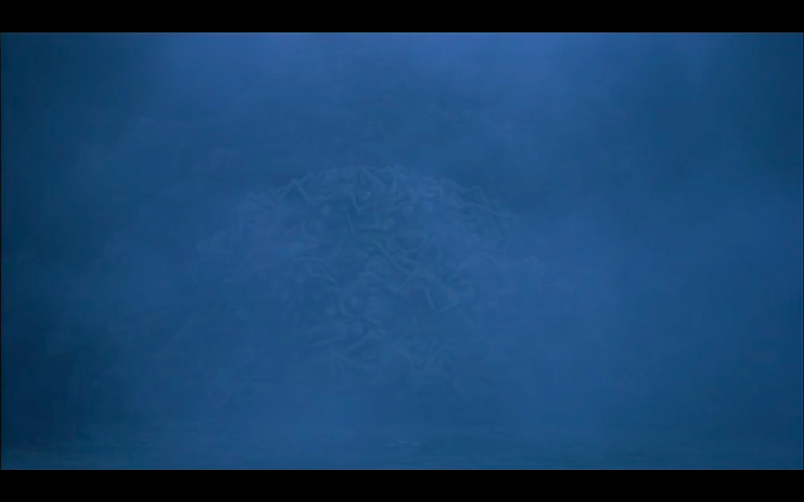
The ultimate signified of the Holocaust?

Slide 16
Nuit et brouillard (Alain Resnais, 1956)

Slide 17
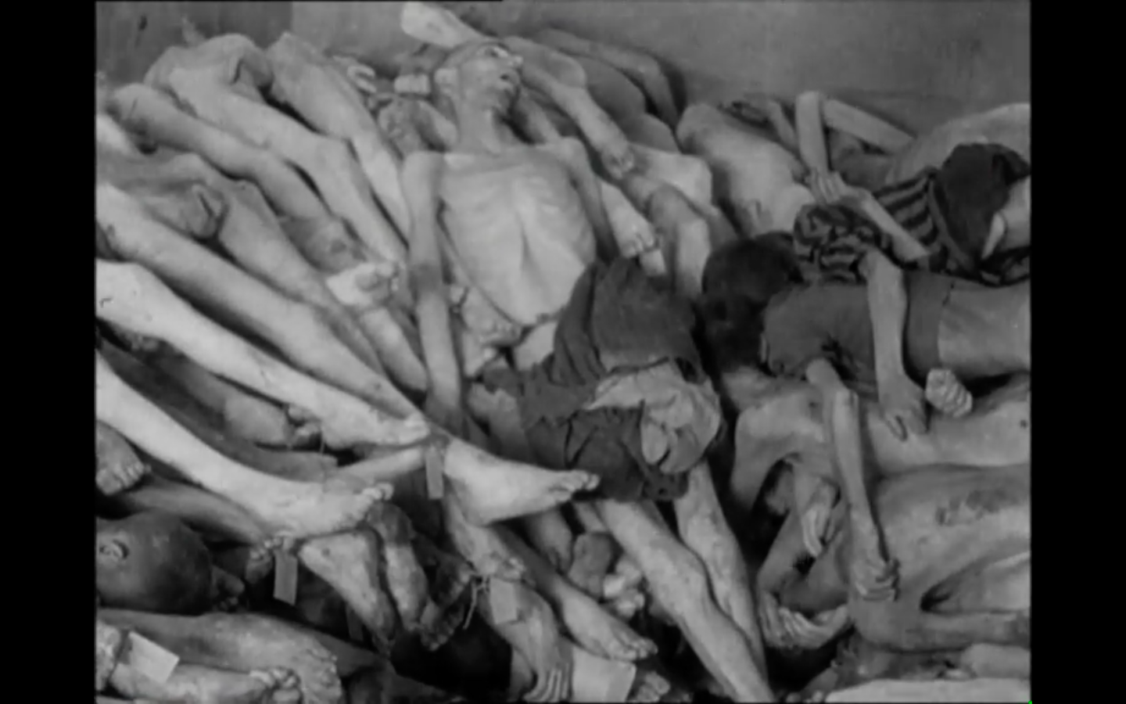
The ultimate signified of the Holocaust?

Slide 18
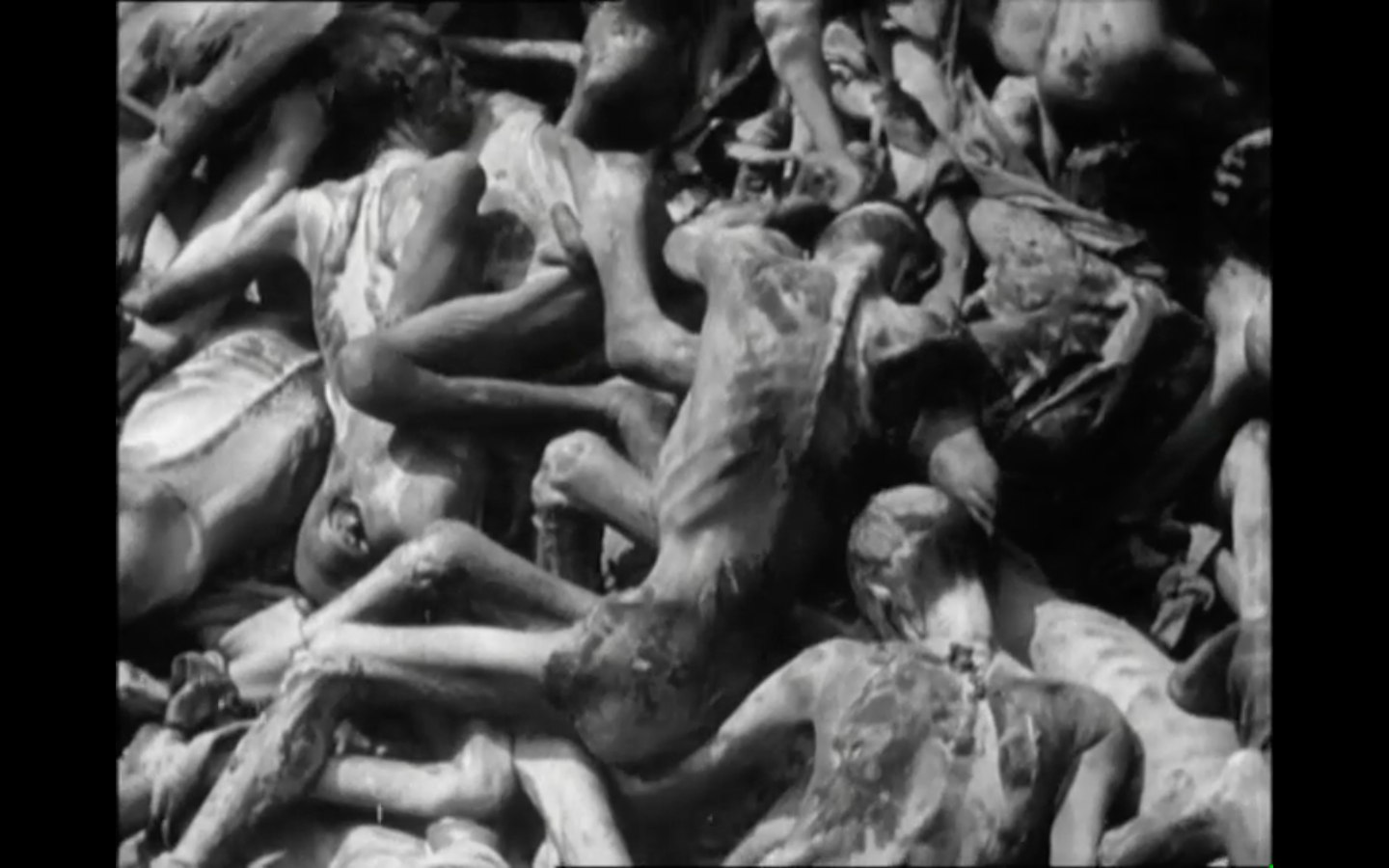
The ultimate signified of the Holocaust?

Slide 19
The ultimate signified of the Holocaust?

Slide 20
Approaches to teaching La vita è bella
By Charles L. Leavitt IV
Italian Teachers Day

