Slide 1
Interdisciplinarity in the classroom
History and Visual Culture in the Italian curriculum
Dr David Brown; Mr Peter Langdale; Prof Giuliana Pieri

Slide 2
Modern History
Futurism and the rise of nationalism in early 20th-C Italy
The Cult of the Duce
The (visual) culture of Fascism
Mussolini and the Italians
Propaganda and the regime

Slide 3
Who?

Slide 4
Where? Tate Modern – Tate Exchange

Slide 5
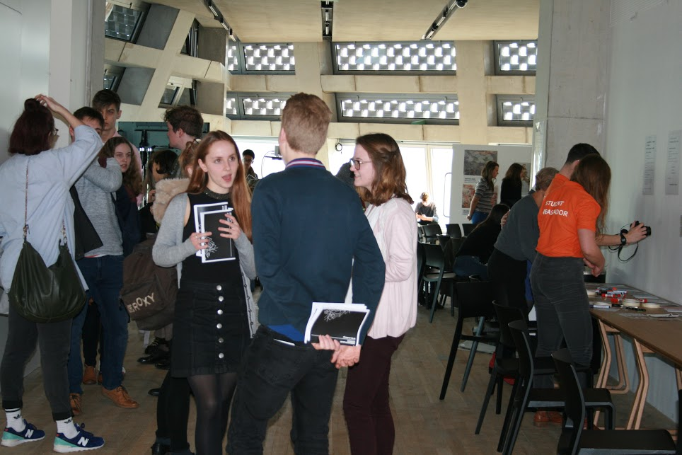
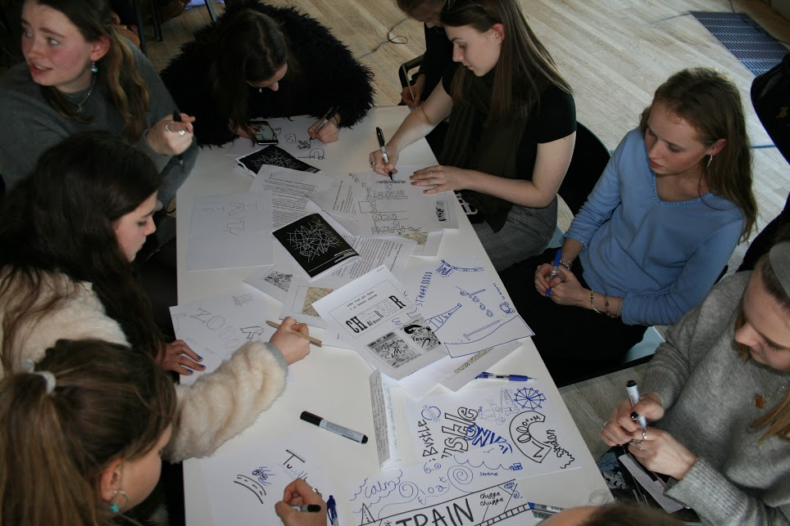
The Interdisciplinary Futurism Project
A-level students of
History
Art History
Design

Slide 6
Giacomo Balla, Velocità astratta, 1913, Pinacoteca Agnelli, Turin.

Slide 7
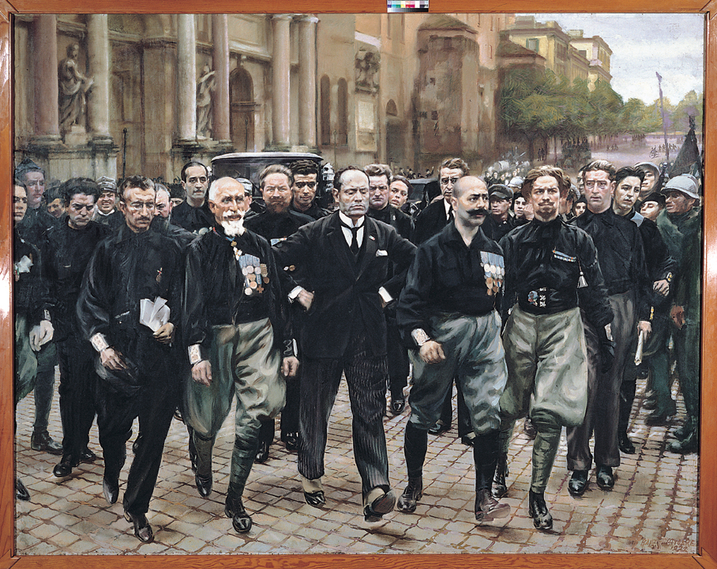
Giacomo Balla, March on Rome, 1931-32. Pinacoteca Agnelli, Turin.

Slide 8
What next?

Slide 9
Presenting the project at conferences in 2018 (Historical Association)
Developing teaching resources and a ‘how to run an interdisciplinary project on Futurism and Fascism’ teachers’ pack.

