Slide 1
Ideas on teaching history in Italian
Tema 4: Dal fascismo ai giorni nostri
L’ascesa di Mussolini al potere (La nascita del Partito Fascista)
Il Fascismo durante la Seconda Guerra Mondiale (Il governo di Mussolini e la dittatura; la vita sotto Mussolini durante la seconda guerra mondiale)
Paper 1 Listening, reading and translation (translation into English will be taken from one of the four themes)
Paper 3 Speaking (discussion on a theme and presentation and discussion on student’s independent research project)

Slide 2
Aspects to note
Italian history barely done at GCSE if at all
German history and a focus on UK and US history predominate
Students may have a very small knowledge of Mussolini but little else

Slide 3
History focus at A Level
Understanding the short and long term factors that led to the rise of fascism and the collapse of liberal italy
Being able to rank causational factors in relation to this
Understanding the specific chronological and geographical differences between the experiences of Italians during the Second World War ie. 1940-1943 and then the experiences of those who lived in the Salo Republic and elsewhere further south

Slide 4
Introduction to Italy
What was Italy like in c1911?
What problems did Italy face?

Slide 5
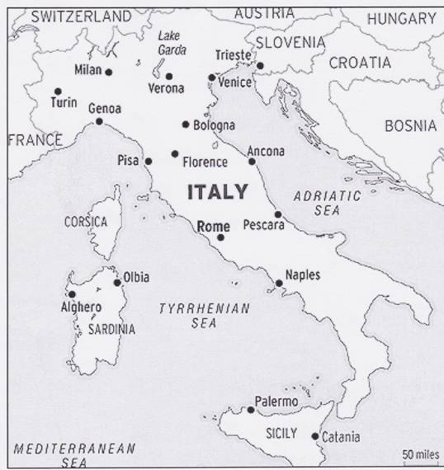
Let’s get to grips with the geography.
Complete the map and notes on page 2 in your booklets using Hite and Hinton page 11 and your textbooks page 274-275

Slide 6
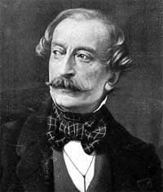
Italy in 1911: the historic background
Italy only became fully unified in 1870
Italians had a strong regional identity
Italians spoke many different dialects
Unification left divisions and some resentment
We have made Italy. Now we must make Italians.
What problems might these divisions cause?
Massimo d’Azeglio,
Italian politician

Slide 7
Engaging with the material to build understanding
Getting the students to build up characters from the period they are studying is a good way to get them to use the history they are studying in more specific ways
Trying to get them to demonstrate knowledge in a better way then just answering questions
Designing electoral posters can be effective if used well
Demonstrating complex understanding through creative methods

Slide 8
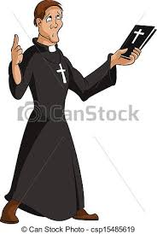
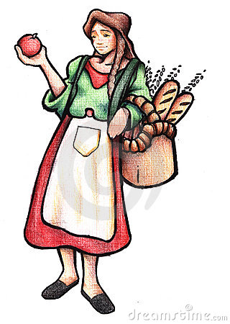
Finally
Create a character in Italy in the 1900s and fill in their view of Italian politics in the speech bubble.

Slide 9
Salo Republic and World War II
Read through pages and design your character - they can either be a partisan, a civilian or a member of the Salo Republic - give them a name and consider what their thoughts, priorities, fears are at this stage of the war.

Slide 10
Poster Activity
Activity: Design a poster for the election of 1919 for the political party you have been given. Use your book pages 304-5.
Parties:
PPI- Catholic Party PSI- Socialist Party
Fasci di Combattimento -Fascist Party Liberal Union - led by Giolitti
Liberals / Democrats/ Radicals - led by Orlando
Poster must have slogan, symbol and 2-3 key policies + your names

Slide 11
Rationale
Discussion and debate can help students learn how to formulate, clear, precise and logical arguments. This task requires research based on previous reading, analysis, synthesis, organisation and evaluation of information. Students are then required to represent this organisation and evaluation visually.

Slide 12
Mussolini’s rise to power 1922
What were the key factors contributing to Mussolini’s appointment as Prime Minister of Italy in October 1922?
From your previous reading discuss and write down the answer to these key questions:
1. What was the Fiume occupation?
2. What does it tell us about post-war Italy?
3. Why is it significant in the rise of Fascism and Mussolini?
4. Why was the Biennio Rosso so important for Mussolini’s popularity?
5. How did the Fascist violence help Mussolini? Who was it most popular with?
6. Why did the Italian middle classes look towards Mussolini for support?

Slide 13
Considering key factors
Moving from concrete knowledge to more abstract understanding:
Students now use the answers to the previous questions to consider key factors relating to Fascism’s appeal
eg strong appeal to nationalism (Fiume), use of violence, strong anti-Communism (Biennio Rosso), appeal to the middle classes, Mussolini’s charismatic leadership etc

Slide 14
Instructions
You are going to construct a ‘Fascist Pizza’ that demonstrates the differing factors contributing to Fascism’s appeal and how they relate to each other
Look at p.8 in the pack

Slide 15
Fascist Pizza Task
Working in pairs you are going to put together ingredients and a recipe that went into the appeal and strength of Fascism
Different aspects of Fascism will be the ingredients. Violence of Fascist squads, charisma of Mussolini, support of middle classes, failure of other parties, Nationalism and promises of strong Italy, role of authorities and elite – could all be part of the pizza
In your recipe state why those ingredients are in there (e.g. to bind the mixture together or to make the pizza attractive to certain people)
Think about the proportion of the ingredients – if something is fundamental to Fascism’s appeal then it is going to make up a big part of your pizza
Use the A3 paper to visually represent your pizza and record your recipe – good ones could be wall worthy

Slide 16
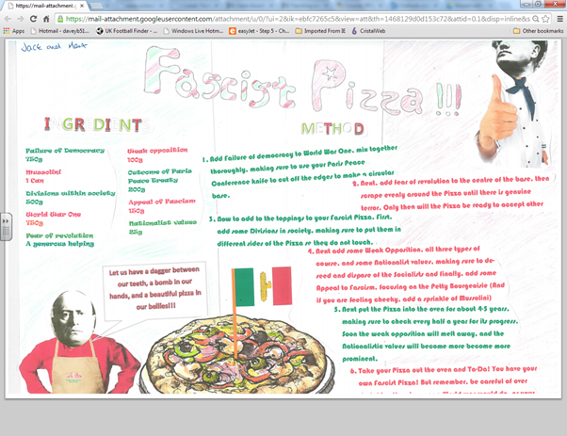

Slide 17
Assessment of causation
Ranking Causality
Historical events usually have many causes. Some are crucial, while some are less important. For causational questions, it is important to understand exactly what role certain factors played in causing historical change.
Look at the causation aspects on page 12 - discuss in in your groups and rank the key causational aspects in the rise of fascism
Using this write an explanation of the rise of fascism on page 13 using evidence from what you have studied

Slide 18
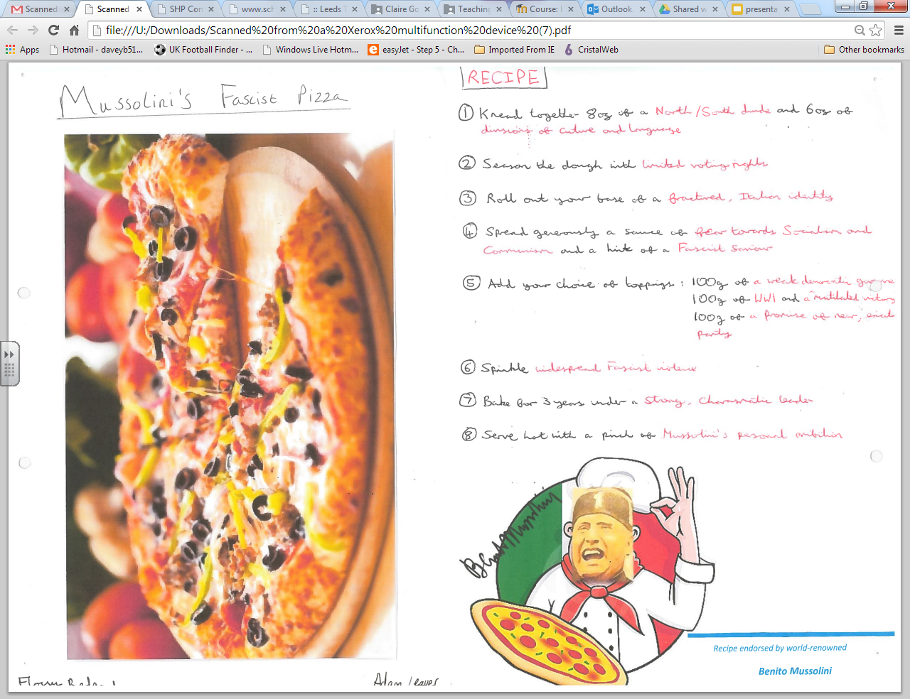

Slide 19
March on Rome
Use pages 313-314 to create a storyboard showing the events of the March on Rome - must include pictures plus description
Then in your groups Complete the exercises on page 17 - who is most responsible for the appointment of Mussolini as Prime Minister in October 1922?
What was the key factor in Mussolini’s appointment as Prime Minister?

Slide 20
Dress your own Mussolini - His outfit should represent the Cult of the Duce. Think outside the box!
Think of a slogan for the cult!

Slide 21
Using images
Images can be a great way to spark student discussion about aspects of history
Visual culture definitely helps to get students to understand priorities, goals, beliefs of differing governments

Slide 22
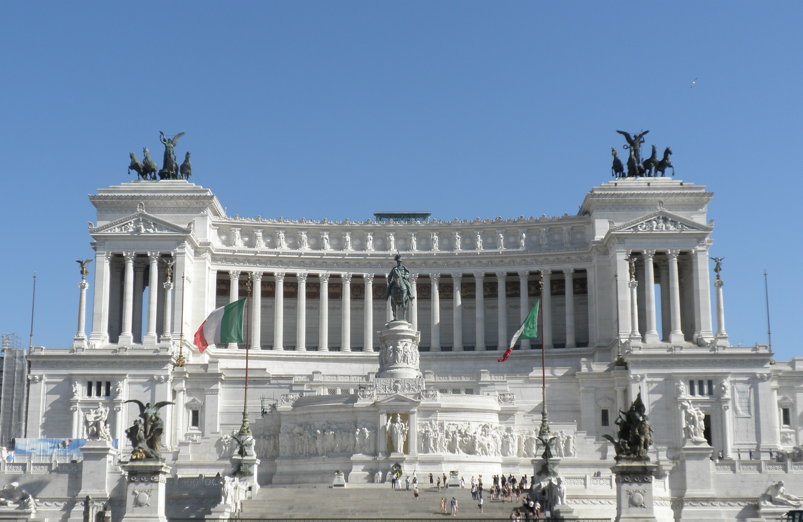
This enormous and flamboyant memorial in Rome to Victor Emmanuel II was completed in 1911. It was built to commemorate the king who was the first ruler of united Italy. Why do you think they built it so many years after unification?

Slide 23
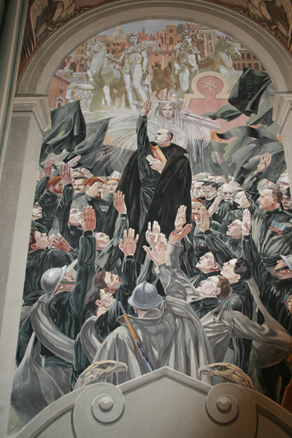

Slide 24
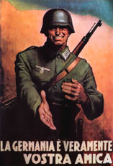
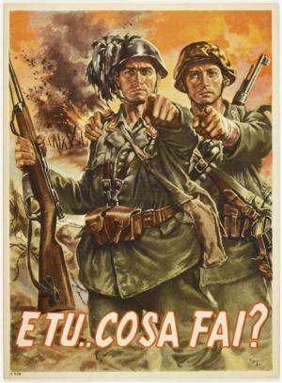
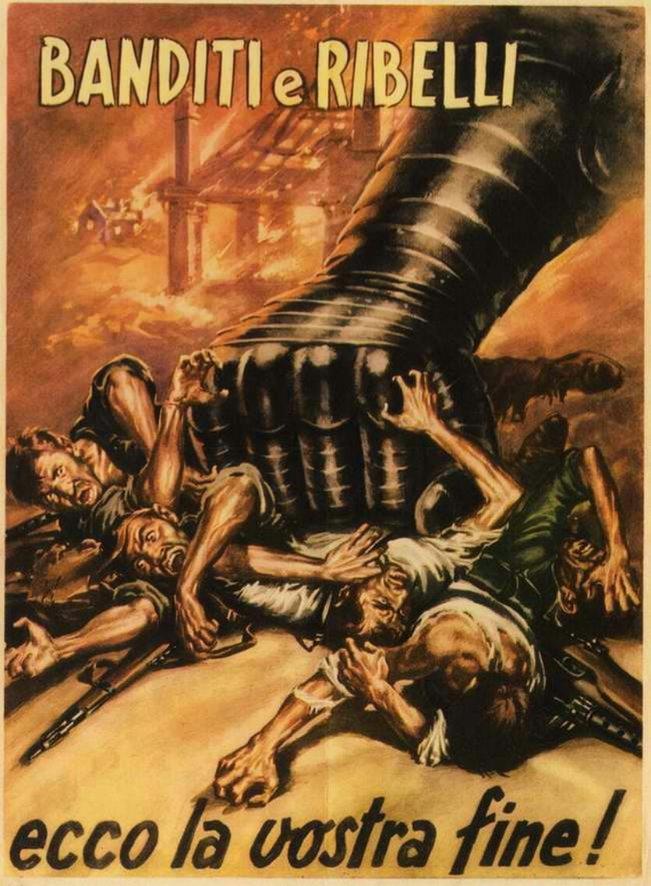

Slide 25
Documentary making
.Good exercise to get students to use their learning on aspects of the regime
.Easy to do with amount of film footage from Italian dictatorship

Slide 26
Youth in Fascist Italy
Exercise: Do the activity related to the youtube videos:
Use theses two clips on youtube which have an Italian voice over.
http://www.youtube.com/watch?v=xf0UhIwuFFk&list=PL312CCB97BB333B97&index=1
( more on younger ones )
http://www.youtube.com/watch?v=uCTOJKAay-w&list=PL312CCB97BB333B97&index=2
( more on older ones )
Use the film to write a voice over in English which :
Summarises the aims of Fascist policy
Explains its main features
Evaluates its successes and failures.

