Slide 1
Jenny Burns, University of Warwick
Routes and roots:
approaches to migration in contemporary Italy

Slide 2
context
approaches to, perspectives on migration to Italy since 1980s
cultural and social impact of migration

Slide 3
Routes

Slide 4
‘Lampedusa’
migration as crisis, emergency
Italy as ‘first responder’
Italy as focal point of European response to migration
Italy made responsible for ‘gatekeeping’ and/or humanitarian response
south to north routes of migration
traffic and trafficking: exploitation, criminality
narratives of victimization and victimhood

Slide 5
Other routes?
http://data2.unhcr.org/en/situations/mediterranean
overland
air
cities, provincial towns and areas
network migration
shuttle migration (seasonal)
return migration
deportation
migration may not be a single journey from point of departure to destination

Slide 6
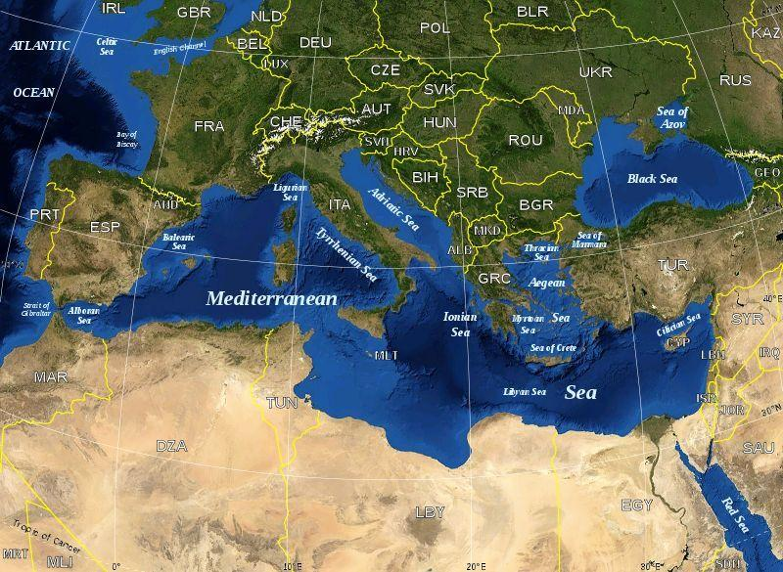

Slide 7
Geographical and historical perspectives
Italy’s historical location as the starting point, mid-point and end-point of Mediterranean journeys;
Italy’s geographical and cultural proximity and porosity in relation to Africa, middle East, eastern Mediterranean.
Italy’s histories of migration out of, within, as well as into the nation-state:
North America, South America and northern Europe – 1890s-1970s (and recently);
Eritrea, Ethiopia, Somalia (Africa Orientale Italiana) – 1890-1960;
Australia, New Zealand, Tasmania – 1950s-1970s;
within Italy, south to north and rural to urban – 1950s-1960s.

Slide 8
Geographical and historical perspectives
escalation in immigration in 1980s-1990s was accompanied by reawakening to Italy’s past as a colonial power from end of C19th to end of WWII (up to 1960, Somalia);
awareness of ‘black Italians’, hybridized identities, e.g. Somali Italian;
formulations of Italian language and culture which exceed the boundaries of the peninsula and islands;
transnational Italian cultures

Slide 9
Roots

Slide 10
Roots
Roots – a sense of belonging – may be predicated upon:
legal and fiscal status – citizenship (jus sanguinis), residency, right to legal work;
language;
cultural inclusion and freedom to worship, socialize, organize politically, prepare and share food, express oneself and be recognized;
homing: finding a home and making a home, both at individual and community levels (mosques, supermarkets, restaurants);
creating networks, real and virtual;
kinship, community, family, social inclusion;
capacity to plan futures.

Slide 11
Roots
These same elements may lead individuals or sectors of indigenous communities to feel correspondingly ‘uprooted’ or estranged in their ‘own’ spaces:
job insecurity;
changes to linguistic landscape; communication challenges;
cultural and social division;
access to services; sustainability of service provision;
changes to the local environment;
new forms and practices of community;
uncertain futures.
migration as political instrument

Slide 12
Cultural and societal impact
‘IMMIGRATION’ >>> intersecting areas of culture and society where particular effects (+ve, -ve) might be seen:
i. GENDER
access of Italian women to labour market facilitated by migrant domestic labour;
gendered experience of migrants: differentiated access to labour market, services, education, language; challenges to and/or entrenchment of cultural values and practices;
gendered employment: sex work, caring, domestic labour; exposure to exploitation; stereotypes and prejudice.

Slide 13
Cultural and societal impact
ii. AGE
provision of labour to counteract effects of an aging population; also caring for that aging population;
transcultural experience and education of younger generations; anxieties about access to and delivery of education to diverse student body;
significant youth unemployment in Italy (37.8% in 2016; EU average 18.7%).

Slide 14
Cultural and societal impact
iii. CLASS:
portability of qualifications and educational achievements;
unemployment and restricted opportunity for migrants and nationals;
‘glass ceiling’; public visibility and value of non-white professionals (politics, TV, sport).
iv. ENVIRONMENT:
changing uses of public spaces upon which sense of local or national community and culture may be constructed: landmark buildings, markets, shops, monuments, public art;
multiethnic zones and ‘ghettoization’.

Slide 15
Linguistic impact
‘Mi a-go lef inna di morrows: io me ne vado domani. Ormai ho fatto il mio tempo, in questo spazio. Devo schiodarmi da qui. Qui è tutto e niente. Pure i confini di questa zona stanno dint o’ core e dint a’ cap da gent: no dint o’ munno.’
Tony, ‘Corvetto’, in Gabriella Kuruvilla, Milano, fin qui tutto bene (Rome and Bari: Laterza, 2012), p. 141.

Slide 16
Sources/resources
Data:
ISTAT
Dossier Statistico Immigrazione 2017
Eurostat
UNHCR
Migrant/minority organizations and networks
G2 Seconde Generazioni
El Ghibli Rivista di Letteratura della Migrazione
Spazio Mondi Migranti

Slide 17
Sources/resources
Stories:
Pap Khouma, Io, venditore di elefanti, ed. by Oreste Pivetta (Milan: Garzanti, 1990)
Gabriella Kuruvilla, Ingy Mubiayi, Igiaba Scego, and Laila Wadia, Pecore nere: Racconti, ed. by Flavia Capitani and Emanuele Coen (Rome and Bari: Laterza, 2005)
Amara Lakhous, Scontro di civiltà per un ascensore a piazza Vittorio (Rome: e/o, 2006)
UNHCR: ‘Storie’
Films:
Lamerica, dir. Gianni Amelio (1994)
Io, l’altro, dir. Mohsen Melliti (2007)
Terraferma, dir. Emanuele Crialese (2011)
Mediterranea, dir. Jonas Carpignano (2015)

Slide 18
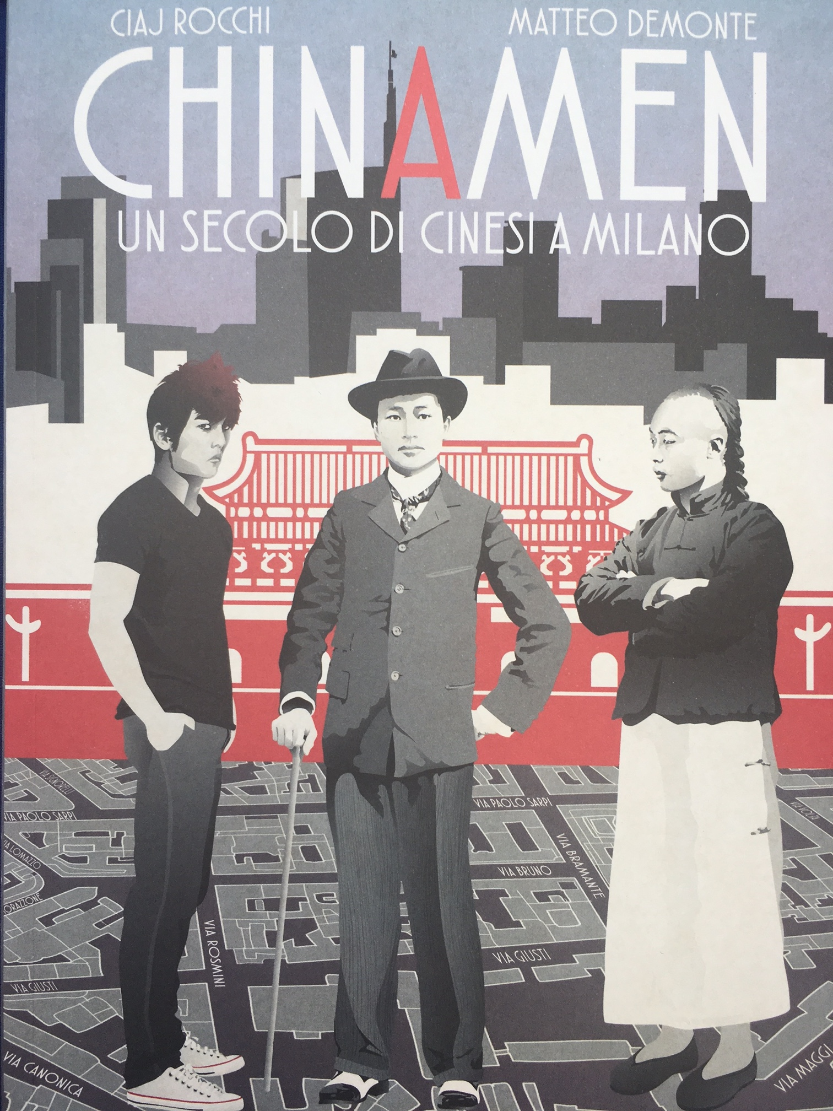
Sources/resources
Graphic novels/graphic journalism:

Slide 19
Sources/resources
Academic texts:
Emma Bond, Guido Bonsaver and Daniele Comberiati, Destination Italy: Representing Migration in Contemporary Media and Narrative (Oxford, Bern: Peter Lang, 2015)
Graziella Parati, Migration Italy: The Art of Talking Back in a Destination Culture (Toronto, Buffalo, NY, and London: University of Toronto Press, 2005)
forthcoming, 2019:
‘Transnational Modern Languages’ series with Liverpool University Press, including Transnational Italian Studies.

