Slide 1
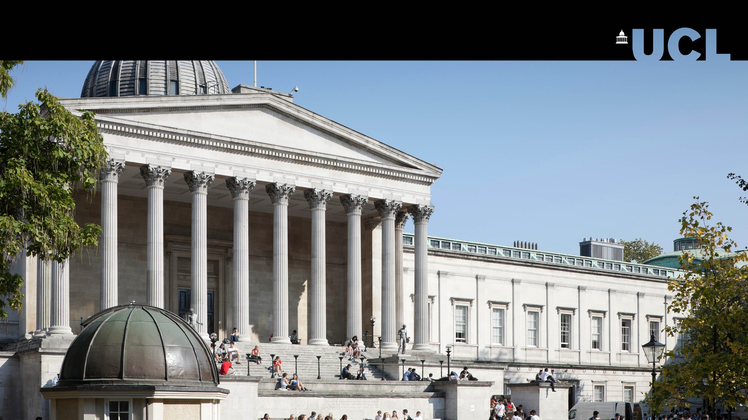
Access and Widening Participation Marina Alessandro UCL SELCS - Italian
SELCS – School of European Languages, Culture and Society
ITALIAN PROGRAMME

Slide 2
The Programme Events and activities to give students an insight into UCL's degree programmes and student life. For students at all levels, from primary through to mature students returning to education. Overall aim, to support progression to university.
SELCS – School of European Languages, Culture and Society
ITALIAN PROGRAMME

Slide 3
SELCS - School of European Languages, Culture and Society Outreach and Widening Participation Programme Raise the aspirations and attainment of people from backgrounds that are under-represented at university.
SELCS – School of European Languages, Culture and Society
ITALIAN PROGRAMME

Slide 4
NEAR PEERS For Sixth Form students TASTER DAYS FOR SCHOOLS Y12 LANGUAGES AND CULTURES RESIDENTIAL SUMMER SCHOOL For Year 12 state school students FREE ONLINE RESOURCES
SELCS – School of European Languages, Culture and Society
ITALIAN PROGRAMME

Slide 5
ITALIAN PROGRAMME Taught and learnt at UCL since 1828. Average intake per academic year: ~60 students (single honours and combined degrees) Workshops aimed at Italian teachers Visiting speakers in schools .
SELCS – School of European Languages, Culture and Society
ITALIAN PROGRAMME

Slide 6
Teacher Training Workshops Maria Cristina Tulisso (Copenhagen): Italiano con il cinema. Edoardo Menegazzo (Ca’ Foscari): La 'Flipped Classroom' nella didattica dell’italiano e l’utilizzo delle nuove tecnologie. Sibylle Nalezinski (UCL): Cultivating in the jungle. Harnessing technology for language teaching and learning. Gloria Visintini (Reading): Language and culture MOOC. Maria Bonaria Urban (Amsterdam): Le città italiane a lezione. Sibylle Nalezinski (UCL): Digitally enhanced Easy Readers as course revision. Marco Mezzadri (Parma): Grammatica e tecnologie: questo matrimonio non s’ha da fare? Nicca Vignotto (Amsterdam): Tecniche teatrali in classe: il "Process Drama", coinvolgimento totale per studenti e insegnante. Giulia Bortolon Guidolin (Ca’ Foscari, Venezia): L’utilizzo della canzone nella didattica della lingua e della cultura italiana. Sibylle Nalesinski (UCL): Using Google Translate to improve student diary entries in MfL learning. Edoardo Menegazzo (Ca’ Foscari): Apprendimento integrato di contenuto e lingua (CLIL) in italiano LS: approccio metodologico e strategie didattiche.
SELCS – School of European Languages, Culture and Society
ITALIAN PROGRAMME

Slide 7
Information Outreach and Widening Participation Tutor for SELCS Christine Sas c.sas@ucl.ac.uk Italian Programme Marina Alessandro m.alessandro@ucl.ac.uk Thank you
SELCS – School of European Languages, Culture and Society
ITALIAN PROGRAMME

